Slide 1
Python Random Module:
Generate Random Numbers and Data

Slide 2
Python random intenger number: Generate random numbers using randint() and randrange().
Python random choice: Select a random item from any sequence such as list, tuple, set.
Python random sample: Select multiple random items (k sized random samples) from a list or set.
Python weighted random choices: Select multiple random items with probability (weights) from a list or set.
Python random seed: Initialize the pseudorandom number generator with a seed value.
Python random shuffle: Shuffle or randomize the any sequence in-place.
Python random float number using uniform(): Generate random float number within a range.
Generate random string and passwords in Python: Generate a random string of letters. Also, create a random password with a combination of letters, digits, and symbols.
Cryptographically secure random generator in Python: Generate a cryptographically secure random number using synchronization methods to ensure that no two processes can obtain the same data simultaneously.
Python Secrets module: Use the secrets module to secure random data in Python 3.6 and above.
Python UUID Module: Generate random Universally unique IDs
Python Random data generation Quiz
Python Random data generation Exercise

Slide 3
How to Use a random module
You need to import the random module in your program, and you are ready to use this module. Use the following statement to import the random module in your code.
import random
Example
import random
print("Printing random number using random.random()")
print(random.random())
# Output 0.5015127958234789
As you can see in the result, we have got 0.50. You may get a different number.
The random.random() is the most basic function of the random module.
Almost all functions of the random module depend on the basic function random().
random() return the next random floating-point number in the range [0.0, 1.0).

Slide 4
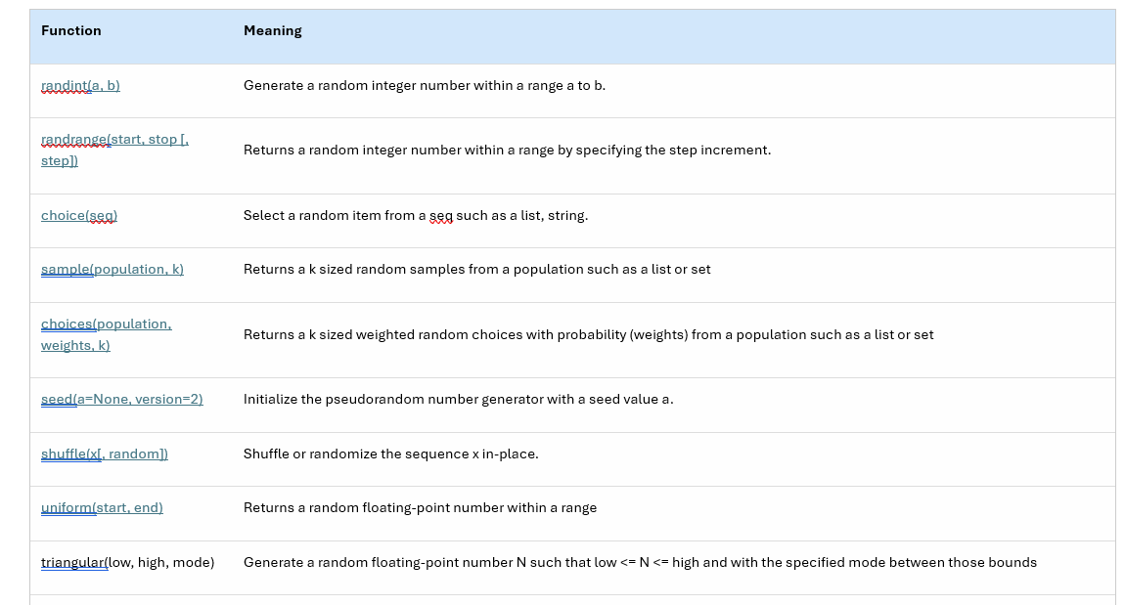
Random module functions:
Now let see the different functions available in the random module and their usage.

Slide 5
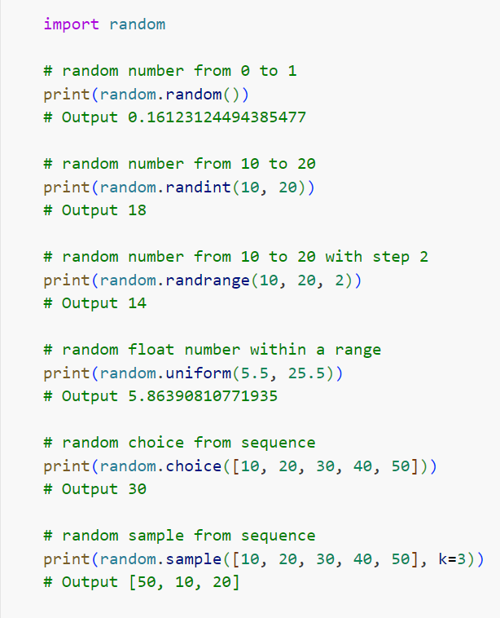
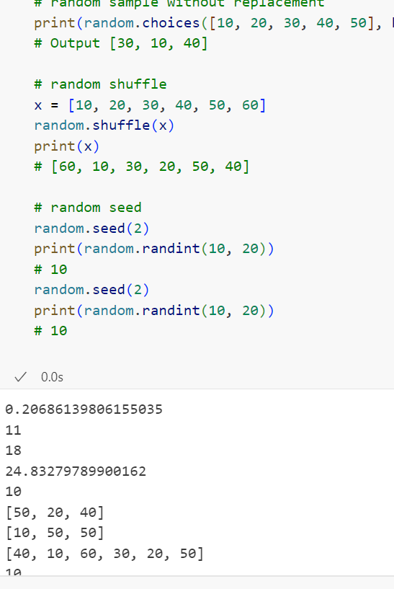

Slide 6
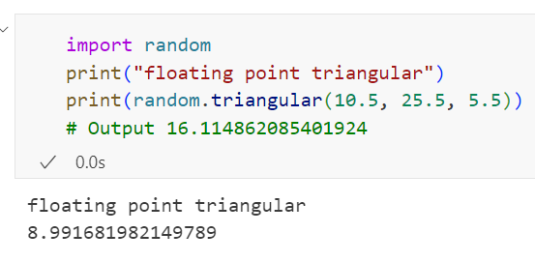
random.triangular(low, high, mode)
The random.triangular() function returns a random floating-point number N such that lower <= N <= upper and with the specified mode between those bounds.
The default value of a lower bound is ZERO, and the upper bounds are one. Moreover, the peak argument defaults to the midpoint between the bounds, giving a symmetric distribution.

Slide 7
Generate random String:
Generate a random string of any length.
Generate the random password, which contains the letters, digits, and special symbols.
Cryptographically secure random generator in Python
Random Numbers and data generated by the random module are not cryptographically secure.
The cryptographically secure random generator generates random data using synchronization methods to ensure that no two processes can obtain the same data simultaneously.
A secure random generator is useful for security-sensitive applications such as OTP generation.
We can use the following approaches to secure the random generator in Python.
The secrets module to secure random data in Python 3.6 and above.
Use the random.SystemRandom class in Python 2.

Slide 8
Get and Set the state of random Generator
The random module has two functions: random.getstate() and random.setstate() to capture the random generator's current internal state. Using these functions, we can generate the same random numbers or sequence of data.
random.getstate()
The getstate() function returns a tuple object by capturing the current internal state of the random generator. We can pass this state to the setstate() method to restore this state as a current state.
random.setstate(state)
The setstate() function restores the random generator's internal state to the state object passed to it.
Note: By changing the state to the previous state, we can get the same random data. For example, If you want to get the same sample items again, you can use these functions.
Example
If you get a previous state and restore it, you can reproduce the same random data repeatedly. Let see the example now to get and set the state of a random generator in Python.

Slide 9
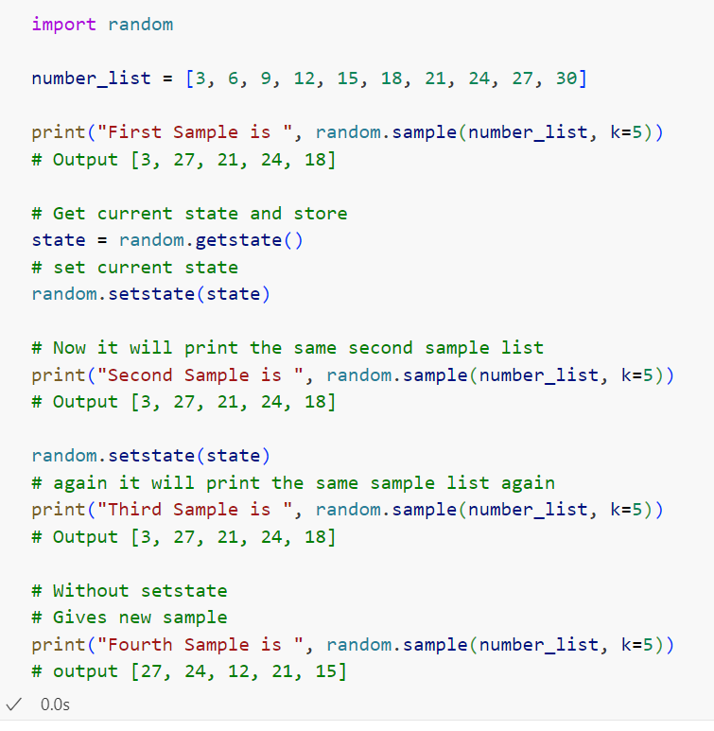
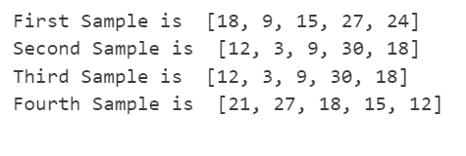
As you can see in the output, we are getting the same sample list because we use the same state again and again

Slide 10
Numpy random package for multidimensional array
PRNG is an acronym for pseudorandom number generator. As you know, using the Python random module, we can generate scalar random numbers and data.
Use a NumPy module to generate a multidimensional array of random numbers. NumPy has the numpy.random package has multiple functions to generate the random n-dimensional array for various distributions.
Create an n-dimensional array of random float numbers
Use a random.rand(d0, d1, …, dn) function to generate an n-dimensional array of random float numbers in the range of [0.0, 1.0).
Use a random.uniform(low=0.0, high=1.0, size=None) function to generate an n-dimensional array of random float numbers in the range of [low, high).

Slide 11
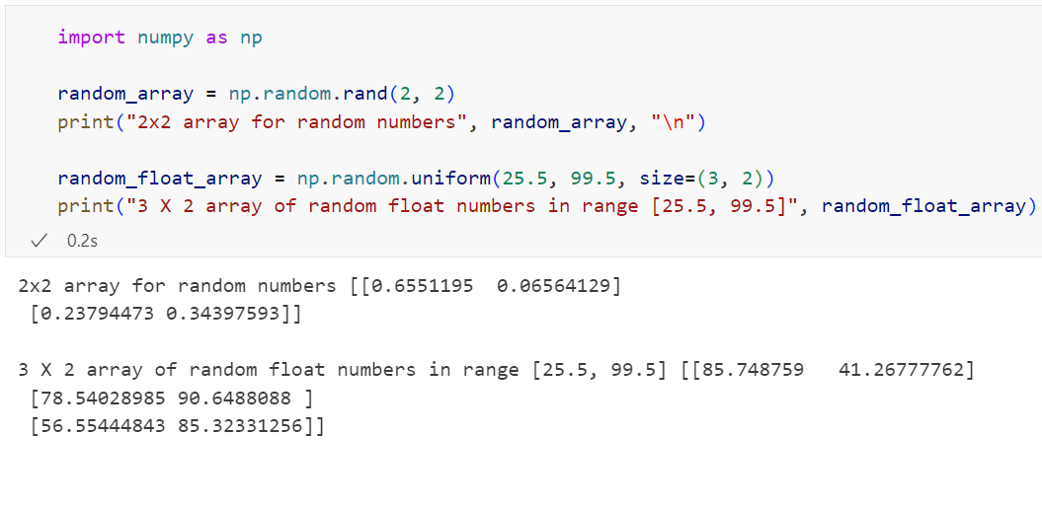

Slide 12
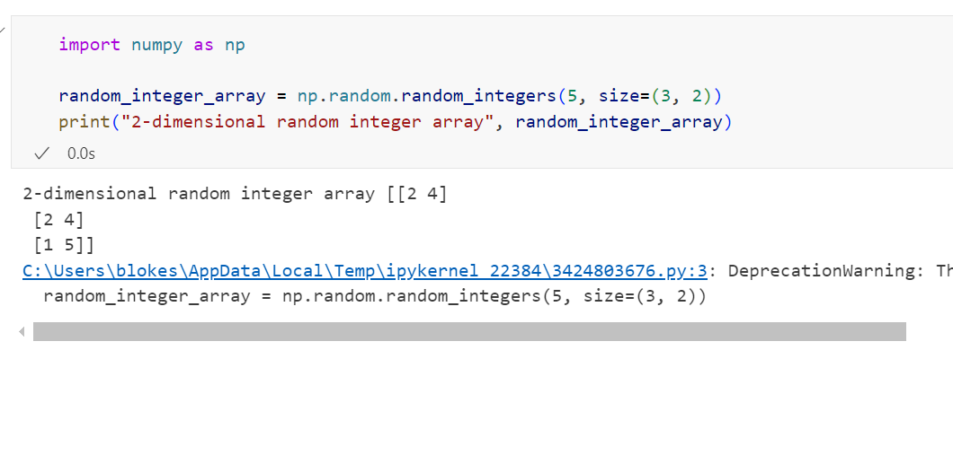
Generate an n-dimensional array of random integers:
Use the random.random_integers(low, high=None, size=None) to generate a random n-dimensional array of integers.

Slide 13
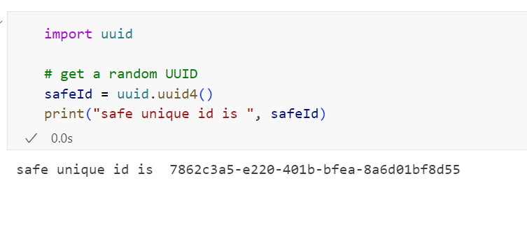
Generate random Universally unique IDs
Python UUID Module provides immutable UUID objects. UUID is a Universally Unique Identifier. It has the functions to generate all versions of UUID. Using the uuid4() function of a UUID module, you can generate a 128 bit long random unique ID ad it's cryptographically safe.
These unique ids are used to identify the documents, Users, resources, or information in computer systems.
Example:

Slide 14
Dice Game Using a Random module
I have created a simple dice game to understand random module functions. In this game, we have two players and two dice.
One by one, each Player shuffle both the dice and play.
The algorithm calculates the sum of two dice numbers and adds it to each Player's scoreboard.
The Player who scores high number is the winner.
Program:

Slide 15
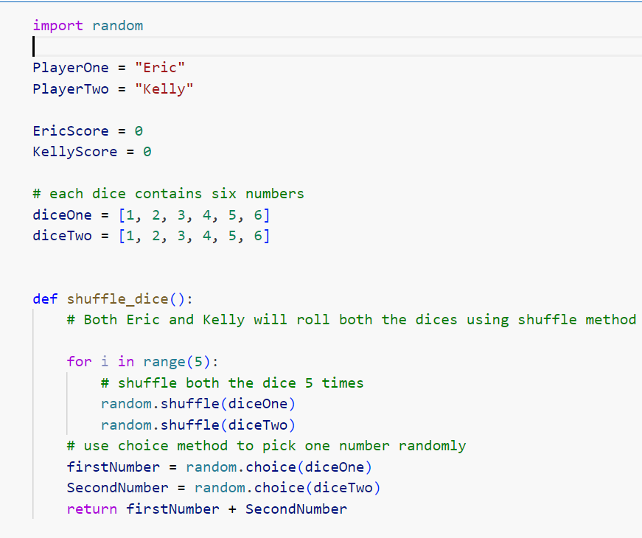

Slide 16
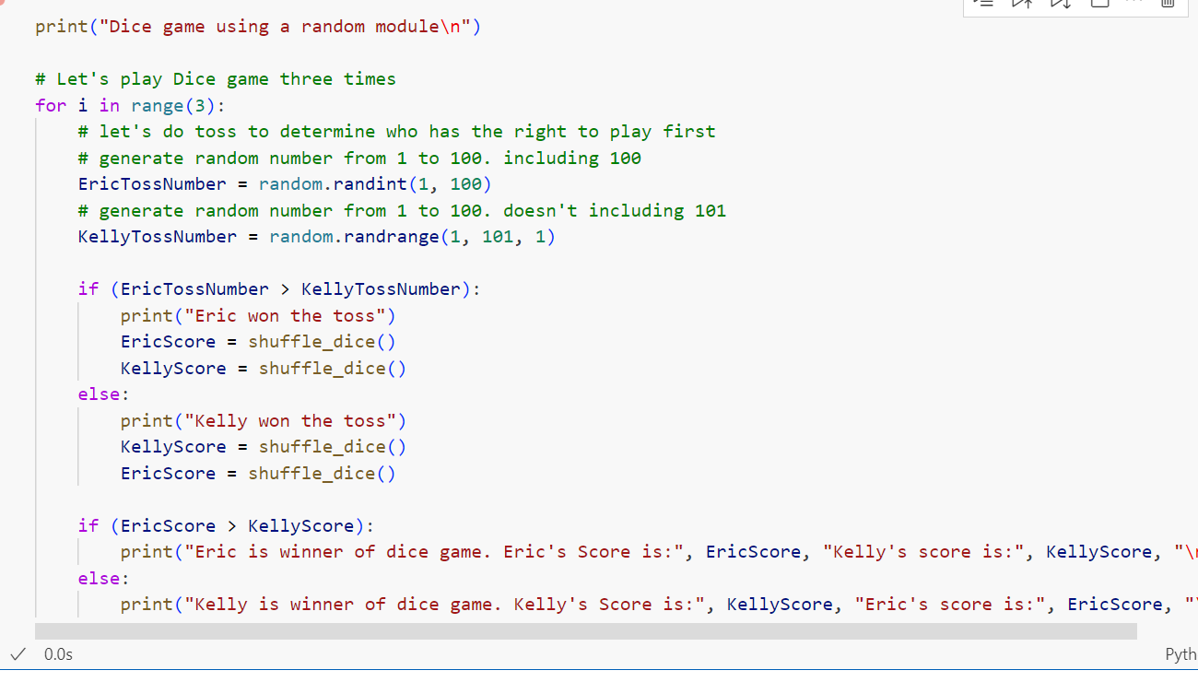

Slide 17
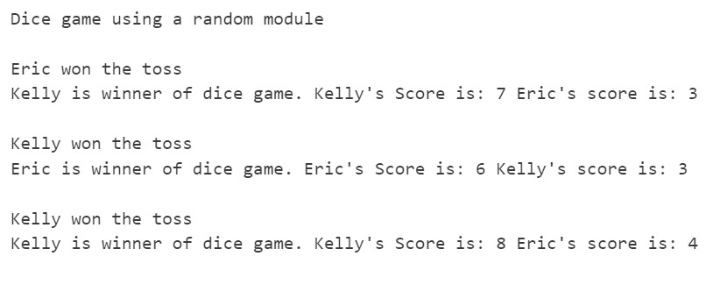

Slide 18
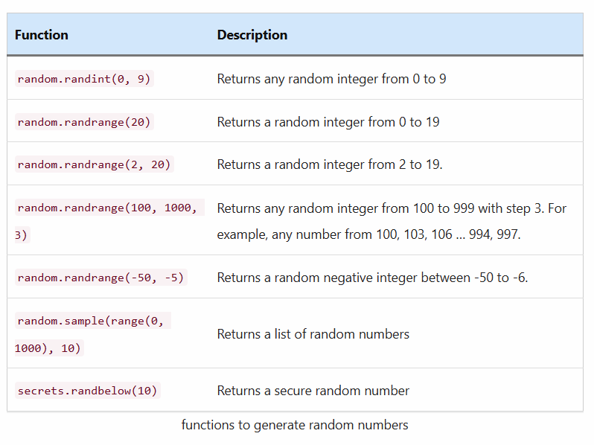
Python random randrange() and randint() to generate random integer number within a range:
we will see how to use the randrange() and randint() functions of a Python random module to generate a random integer number.
Using randrange() and randint() functions of a random module, we can generate a random integer within a range. In this lesson, you’ll learn the following functions to generate random numbers in Python. We will see each one of them with examples.

Slide 19
Contents
How to use random.randint()
random.randint() example of generating random number
random.randrange() to generate random integers within a range
Syntax
random.randrange() examples
Random number of a specific length
Random integer number multiple of n
Random negative integer
Generate random positive or negative integer
Randomly generate 1 or -1
Generate a list of random integer numbers
Create a list of random numbers without duplicates
Sort random numbers list
Generate a secure random integer
Create a multidimensional array of random integers
Points to remember about randint() and randrange()

Slide 20
How to use random.randint()
Syntax:
random.randint(start, stop)
This function returns a random integer between a given start and stop integer.
Parameters:
It takes two parameters. Both are mandatory.
start: It is the start position of a range. The default value is 0 if not specified.
stop: It is the end position of a range.
Return value:
It will generate any random integer number from the inclusive range. The randint(start, stop) consider both the start and stop numbers while generating random integers

Slide 21
How to use Python randint() and randrange() to get random integers
Import random module
Use Python’s random module to work with random data generation.
import it using a import random statement.
Use randint() Generate random integer
Use a random.randint() function to get a random integer number from the inclusive range. For example, random.randint(0, 10) will return a random number from [0, 1, 2, 3, 4, 5, 6, 7, 8 ,9, 10].
Use the randrnage() function to generate a random integer within a range
Use a random.randrange() function to get a random integer number from the given exclusive range by specifying the increment. For example, random.randrange(0, 10, 2) will return any random number between 0 and 20 (like 0, 2, 4, 6, 8).

Slide 22
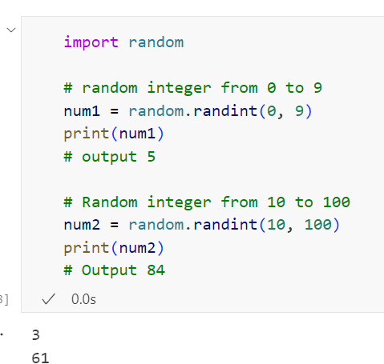
random.randint() example of generating random number
Note: You cannot use float numbers in randint(). It will raise a ValueError ( non-integer stop for randrange()) if you use non-integer numbers. Please, read how to generate a random float number within a range.
random.randrange() to generate random integers within.

Slide 23
a range
Now let’s see how to use the random.randrange() function to get a random integer number from the given exclusive range by specifying the increment.
Syntax
random.randrange(start, stop[, step])
This function returns a random integer from a range(start, stop, step). For example, random.randrange(0, 10, 2) will generate any random numbers from [0, 2, 4, 6, 8].
Parameters
It takes three parameters. Out of three, two parameters are optional. i.e., start and step are optional.
start: it is the star number in a range. i.e., lower limit. The default value is 0 if not specified.
stop: It is the end/last number in a range. It is the upper limit.
step: Specify the increment value in range. The generated random number is divisible by step. The default value is 1 if not specified.

Slide 24
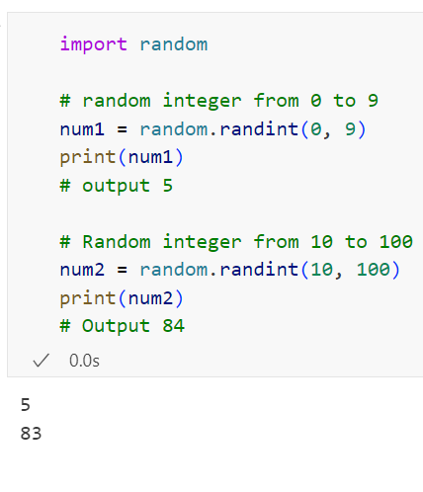
random.randrange() examples:
In the following example, we are trying to print a random int in a given range. This example demonstrates all the variants of random.randrange() function.
Note:
The randrange() doesn’t consider the stop number while generating a random integer. It is an exclusive random range. For example, randrange(2, 20, 2) will return any random number between 2 to 20, such as 2, 4, 6, …18. It will never select 20.
Same as randint(), you cannot use float value in randrange() too. It will raise a ValueError (non-integer arg 1 for randrange()) if you use non-integers.

Slide 25
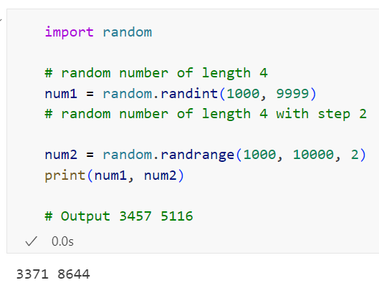
Random number of a specific length
Let’s see how to generate a random number of length n. For example, any random number of length four, such as 7523, 3674. We can accomplish this using both randint() randrange().
Note: As you can see, we set a start = 1000 and a stop = 10000 because we want to generate the random number of length 4 (from 1000 to 9999).

Slide 26
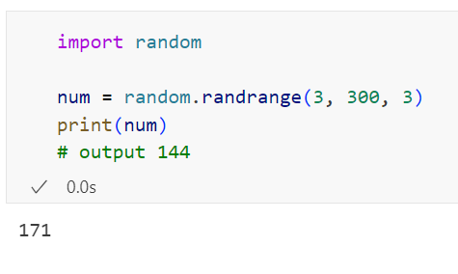
Random integer number multiple of n
For example, let’s generate a random number between x and y multiple of 3 like 3, 6, 39, 66.

Slide 27
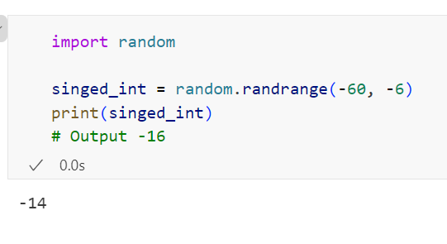
Random negative integer
Let’s see how to generate a random negative integer between -60 to -6.

Slide 28
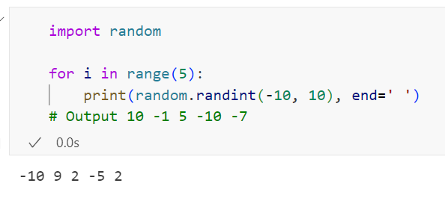
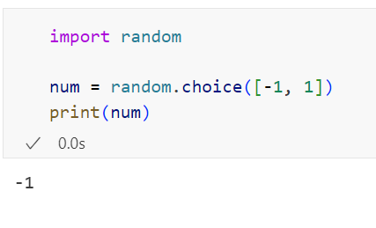
Generate random positive or negative integer
Randomly generate 1 or -1
Note: we used random.choice() to choose a single number from the list of numbers. Here our list is [-1, 1].

Slide 29
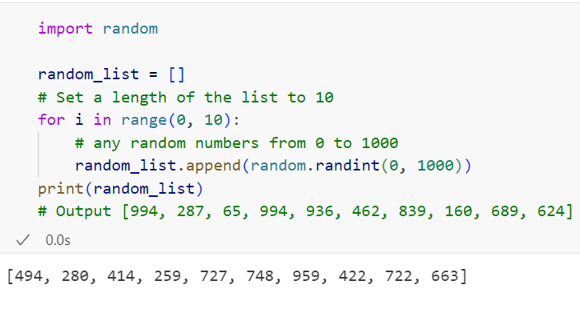
Generate a list of random integer numbers
In this section, we will see how to generate multiple random numbers. Sometimes we need a sample list to perform testing. In this case, instead of creating it manually, we can create a list with random integers using a randint() or randrange(). In this example, we will see how to create a list of 10 random integers.

Slide 30
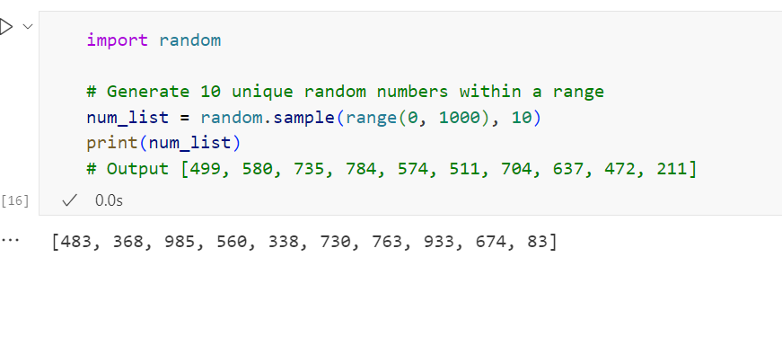
Create a list of random numbers without duplicates
Note: In the above example, there is a chance of occurring a duplicate number in a list.
If you want to make sure each number in the list is unique, use the random.sample() method to generate a list of unique random numbers.
The sample() returns a sampled list of selected random numbers within a range of values.
It never repeats the element so that we can get a list of random numbers without duplicates
Note: You can also use the step parameter of the range() function to specify the increment. For example, you want a list of 10 random numbers, but each integer in a list must be divisible by 5, then use random.sample(range(0, 1000, 5), 10)

Slide 31
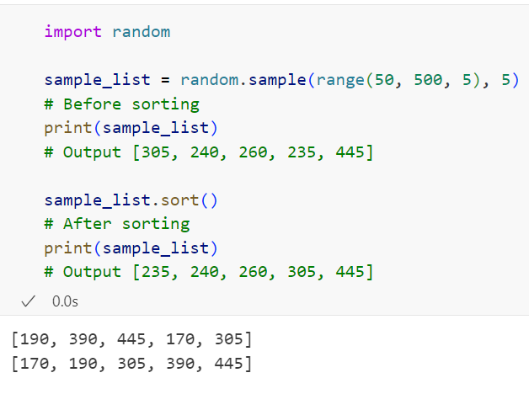
Sort random numbers list
Use the sort() function to sort a list of random integers in ascending order

Slide 32
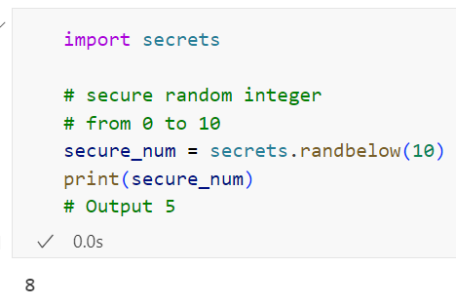
Generate a secure random integer:
Above all, examples are not cryptographically secure. The cryptographically secure random generator generates random numbers using synchronization methods to ensure that no two processes can obtain the same number simultaneously.
If you are producing random numbers for a security-sensitive application, then you must use this approach.
Use the secrets module if you are using a Python version higher than 3.6.
If you are using Python version less than 3.6, then use the random.SystemRandom().randint() or random.SystemRandom().randrange() functions.

Slide 33
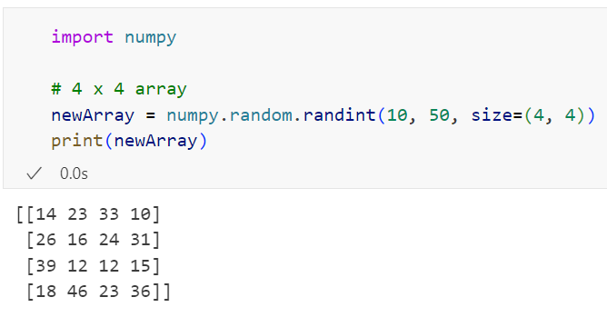
Create a multidimensional array of random integers
Python’s NumPy module has a numpy.random package to generate random data. To create a random multidimensional array of integers within a given range, we can use the following NumPy methods:
randint()
random_integers()
np.randint(low[, high, size, dtype]) to get random integers array from low (inclusive) to high (exclusive).
np.random_integers(low[, high, size]) to get random integer’s array between low and high, inclusive.
Now, Let see the example: Generate a 4 x 4 array of ints between 10 and 50, exclusive:

Slide 34
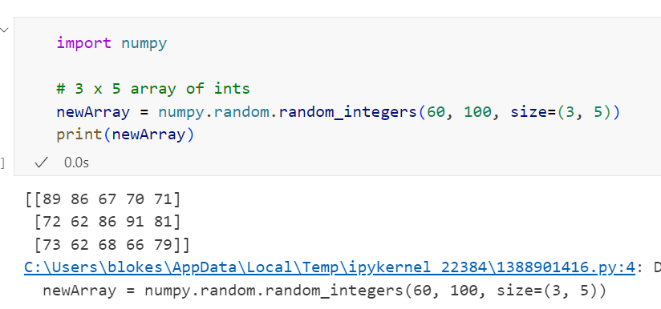
Generate a 5 x 3 array of random integers between 60 and 100, inclusive.

Slide 35
Points to remember about randint() and randrange()
Use randint() when you want to generate a random number from an inclusive range.
Use randrange() when you want to generate a random number within a range by specifying the increment. It produces a random number from an exclusive range.
You should be aware of some value constraints of a randrange() function.
The randint() rand randrange() works only with integers. You cannot use float numbers.
The step must not be 0. If it is set to 0, you will get a ValueError: zero step for randrange()
The start should not be greater than stop if you are using all positive numbers. If you set start greater than stop, you will get a ValueError: empty range for randrange()

Slide 36
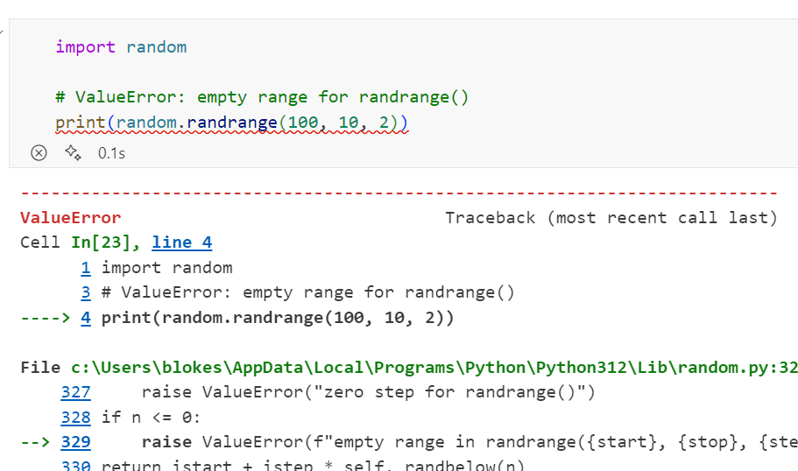

Slide 37
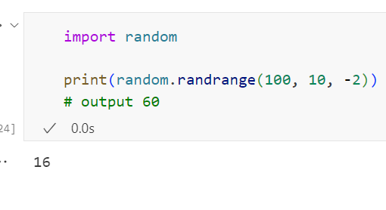
But, you can also set a start value greater than stop if you are using a negative step value.

Slide 38
Python random choice() function to
select a random item from a List and Set

Slide 39
Python random choice() function to select a random item from a List and Set
Python provides a straightforward and efficient way to select a random item from a list and other sequence types using the built-in random module. In this article, we’ll explore different approaches to choose a random element from a list in Python.
contents
random.choice() function to Select a Random Element from a List in Python
random.randint() and indexing to choose random element from list
Select multiple random choices from a list
Random choices without repetition
A random choice from a Python set
Random choice within a range of integers
Get a random boolean in using random.choice()
Random choice from a tuple
Random choice from dictionary
Randomly choose an item from a list along with its index position
Choose a random element from multiple lists with equal probability
Choose a random element from a multidimensional array
A random choice from a 2d array
Random choice from 1-D array
Secure random choice
Randomly choose the same element from the list every time
Randomly choose an object from the List of Custom Class Objects

Slide 40
random.choice() function to Select a Random Element from a List in Python
Use the random.choice() function to choose a random element from a list in Python. For example, we can use it to select a random name from a list of names.
Below are the steps and examples to choose a random item from a list.
Import the random module: This module implements pseudo-random number generators for various distributions. See documentation. The random module in Python offers a handy choice() function that simplifies the process of randomly selecting an item from a list. By importing the random module, you can directly call the random.choice().
Use the random.choice() method: The choice() function takes one argument: the no-empty sequence like a list, tuple, string, or any iterable like range. Pass your list as an argument, and It will return a random element from it.
Use the random.choice() method: The choice() function takes one argument: the no-empty sequence like a list, tuple, string, or any iterable like range. Pass your list as an argument, and It will return a random element from it.
Note: The choice() function returns a random element from the non-empty sequence. (A sequence can be a list, string, or tuple.) If the list or sequence is empty will raise IndexError (cannot choose from an empty sequence).
Now, Let’s assume you have the following list of movies. This list contains five movies. Let’s see how to choose a random movie name from it.

Slide 41
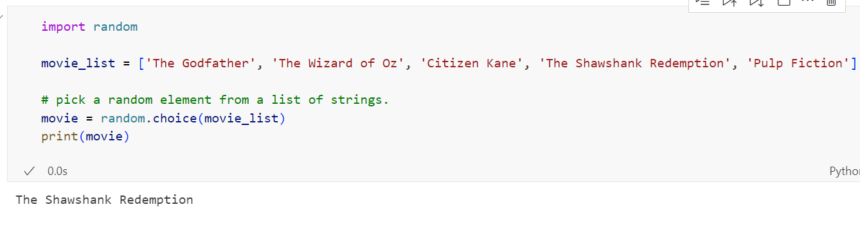
Example: Choose a random item from a list
Now, Let’s assume you have the following list of movies. This list contains five movies. Let’s see how to choose a random movie name from it.
As you can see, this code used the random module and the choice() function to choose a random element, “The Godfather” from the list.
Also, you can use the following variations of random.choice() functions to generate a random item from a sequence. We will see each one of them with examples.

Slide 42
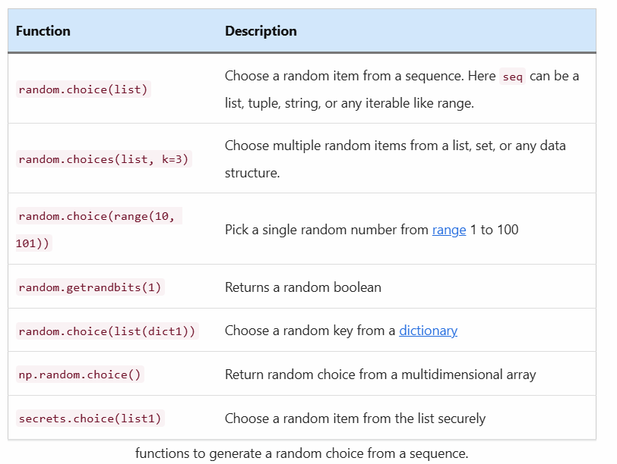

Slide 43
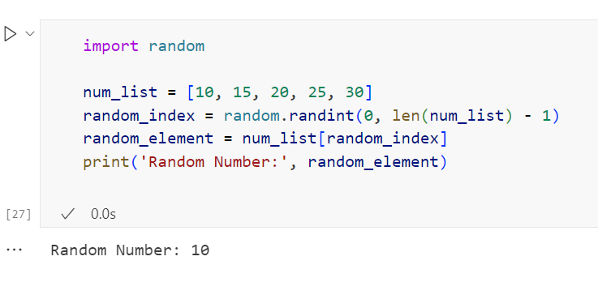
random.randint() and indexing to choose random element from list
Another approach to selecting a random element from a list involves using the randint() function from the random module to generate a random index within the range of the list. By using this index, you can access and retrieve the corresponding element from the list.
The random.randint() function takes two arguments: the minimum and maximum values, and it returns a random integer between those two values.
Example:

Slide 44
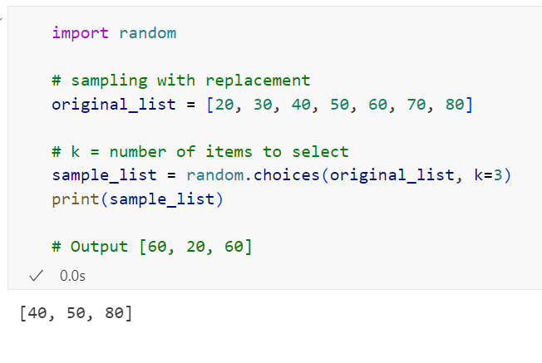
Select multiple random choices from a list
The random.choice() function chooses only a single element from a list. If you want to select more than one item from a list or set, use the random sample() or choices() functions instead.
random.choices(population, weights=None, *, cum_weights=None, k=1)
The random.choices() method was introduced in Python version 3.6, and it can repeat the elements. It is a random sample with a replacement.
Using the random.choices(k) method, we can specify the sampling size. Here k is the number of elements to select from a list.
Example: Choose three random elements from a list
As you can see, this code used the random.choices() with 3 sampling size (the total number of items to select randomly). We got a few repeated numbers in the output because the choices() function can repeat elements

Slide 45
Random choices without repetition
Use the random.sample() function when you want to choose multiple random items from a list without repetition or duplicates.
There is a difference between choice() and choices().
The choices() was added in Python 3.6 to choose n elements from the list randomly, but this function can repeat items.
The choices() function is mainly used to implement weighted random choices to choose multiple elements from the list with different probabilities.

Slide 46
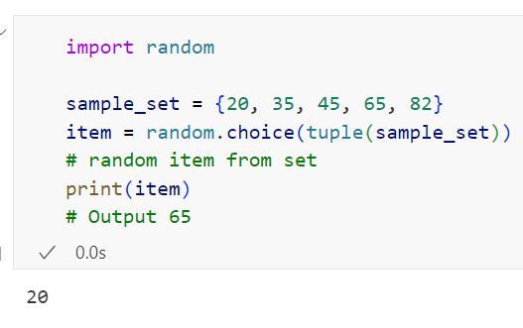
A random choice from a Python set
Python Set is an unordered collection of items. If we pass the set object directly to the choice function, we will get the TypeError ('set' object does not support indexing).
So we can’t choose random items directly from a set without copying them into a tuple.
To choose a random item from a set, first, copy it into a tuple and then pass the tuple to the choice() function

Slide 47
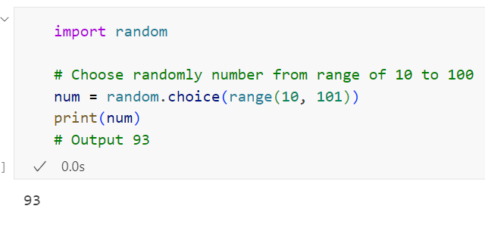
Random choice within a range of integers
Python range() generates the integer numbers between the given start integer to the stop integer. In this example, we will see how to use the choice() to pick a single random number from a range of integers.
Example:

Slide 48
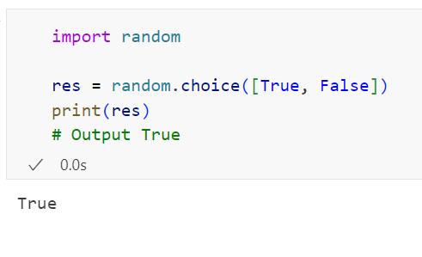
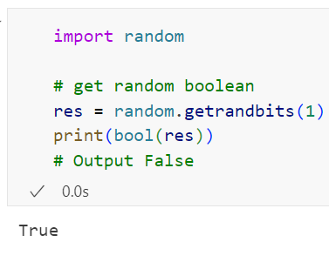
Get a random boolean in using random.choice()
In Python, boolean values are either True or False. Such as flip a coin to select either coin head and tail randomly. Let’s see how to choose a random boolean value, either True or False
Example:
Also, you can use the random.getrandbits() to generate random Boolean in Python fastly and efficiently.

Slide 49
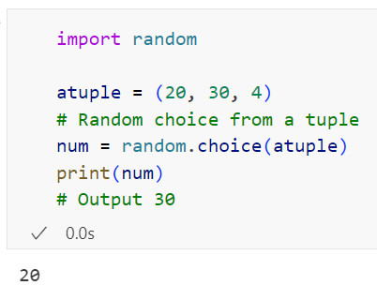
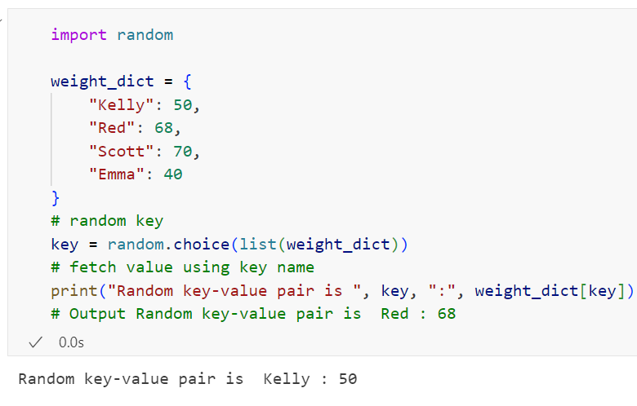
Random choice from a tuple
Same as the list, we can choose a random item out of a tuple using the random.choice().
Random choice from dictionary
A dictionary is an unordered collection of unique values stored in (Key-Value) pairs. Let’s see how to use the choice() function to select random key-value pair from a Python dictionary.
Note: The choice() function of a random module doesn’t accept a dictionary. We need to convert a dictionary (dict) into a list before passing it to the choice() function.

Slide 50
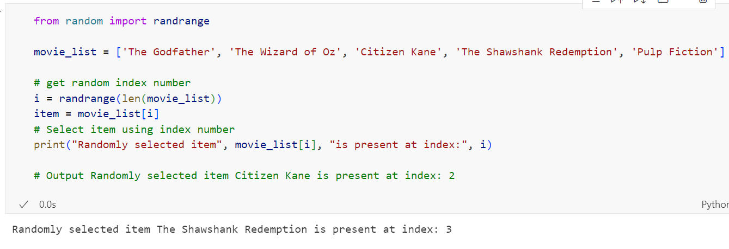
Randomly choose an item from a list along with its index position
We often need an item’s index position along with its value. You can accomplish this using a randrange() function. So let’s see how to randomly choose an item from a list along with its index position.

Slide 51
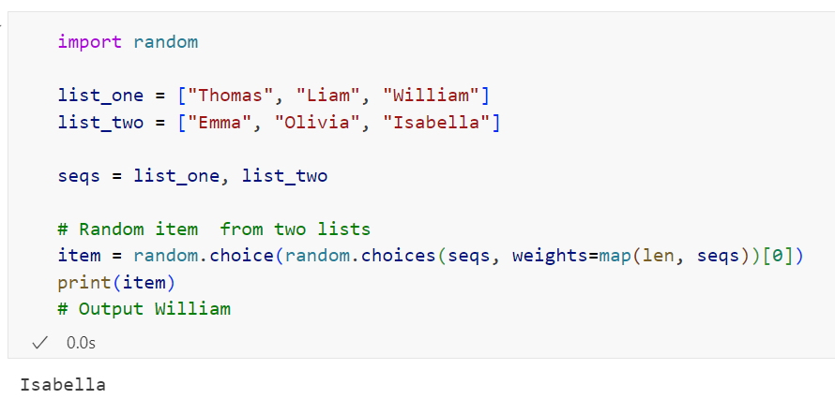
Choose a random element from multiple lists with equal probability
Equal probability means each item from all lists has a fair chance of being selected randomly.
After the introduction of choices() in Python 3.6, it is now easy to generate random choices from multiple lists without needing to concatenate them. Let’s see how to choose items randomly from two lists.
See Weighted random choice for more detail.

Slide 52
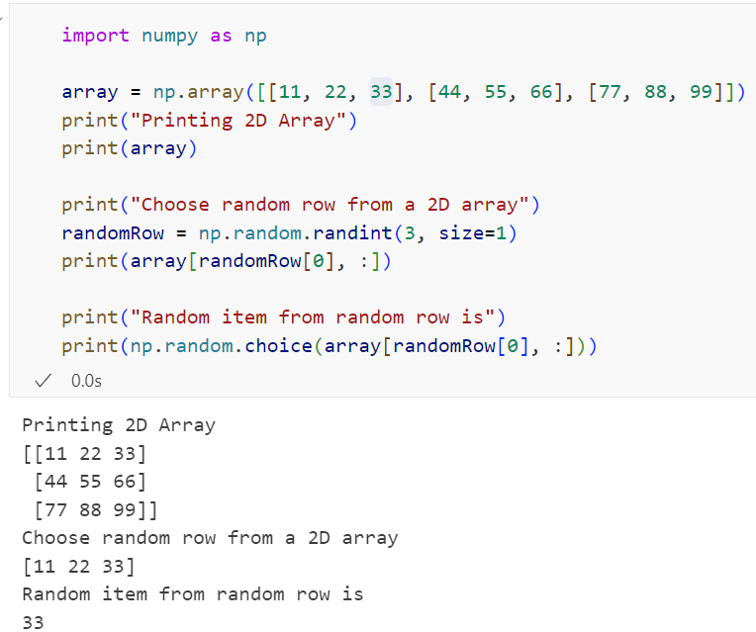
Choose a random element from a multidimensional array
Most of the time, we work with 2d or 3d arrays in Python.
Use the numpy.random.choice() function to generate random choices and samples from a NumPy multidimensional array.
Using this function, we can get single or multiple random numbers from the n-dimensional array with or without replacement.
A random choice from a 2d array
Multiple executions will get several outputs

Slide 53
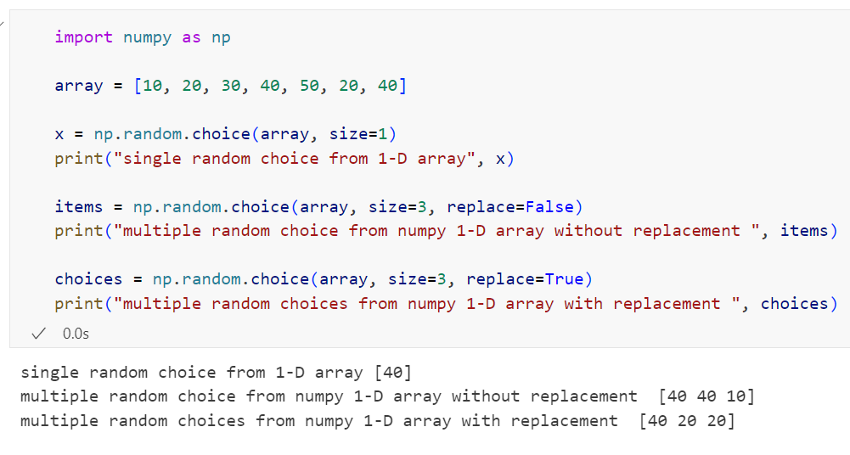
Random choice from 1-D array

Slide 54
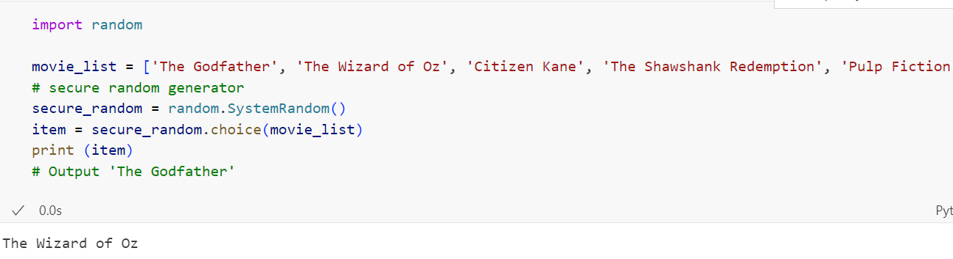
Secure random choice
Note: Above all, examples are not cryptographically secure. If you are using it to pick a random item inside any security-sensitive application, then secure your random generator and use random.SystemRandom().choice() instead of random.choice().

Slide 55
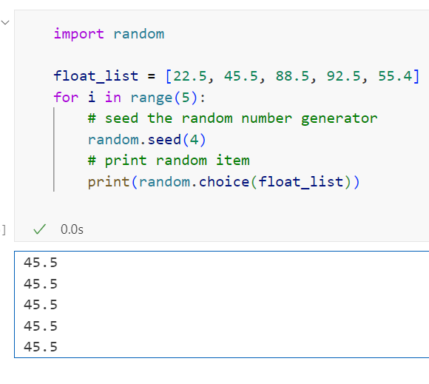
Randomly choose the same element from the list every time
Choosing the same element out of a list is possible. We need to use the random.seed() and random.choice() function to produce the same item every time. Let’s see this with an example.

Slide 56
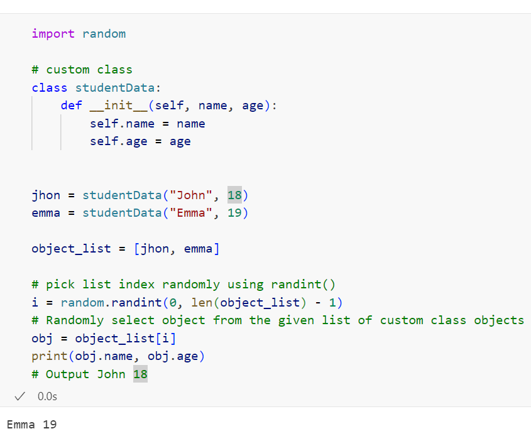
Randomly choose an object from the List of Custom Class Objects
For example, you have a list of objects and want to select a single object from the list. A list of objects is nothing but a list of user-defined class objects. Let’s see how to choose a random object from the List of Custom class objects.

Slide 57
Python random sample() to choose multiple items from any sequence
Will learn how to use the random.sample() function to choose sample/multiple items from a Python list, set, and dictionary. We will also see how to generate a random sample array from a sizeable multidimensional array in Python.
Python’s random module provides a sample() function for random sampling, randomly picking more than one element from the list without repeating elements. It returns a list of unique items chosen randomly from the list, sequence, or set. We call it random sampling without replacement.
In simple terms, for example, you have a list of 100 names, and you want to choose ten names randomly from it without repeating names, then you must use random.sample().
Note: Use the random.choice() function if you want to choose only a single item from the list.

Slide 58
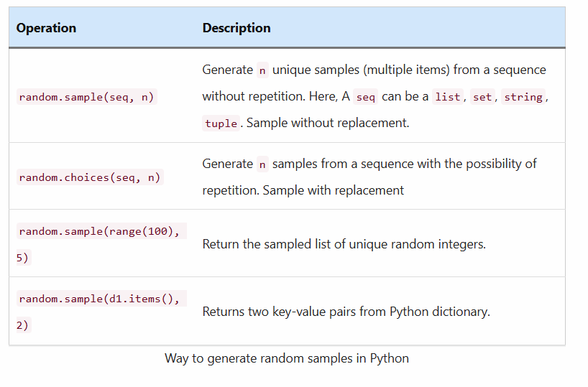

Slide 59
Contents:
How to use random.sample()
Syntax
random sample() example to select multiple items from a list without repetition
Points to remember about random.sample()
random sample with replacement to including repetitions
Generate the sampled list of random integers
A random sample from the Python set
Random sample from Python dictionary
Random seed to get the same sample list every time
Get a sample array from a multidimensional array
random.sample() function Error and exception

Slide 60
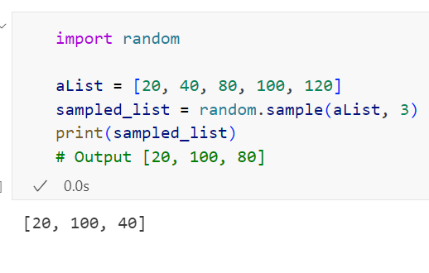
How to use random.sample()
It returns a new list containing the randomly selected items.
Syntax
random.sample(population, k)
Arguments
The sample() function takes two arguments, and both are required.
population: It can be any sequence such as a list, set, and string from which you want to select a k length number.
k: It is the number of random items you want to select from the sequence. k must be less than the size of the specified list.
It raises a TypeError if you miss any of the required arguments.
random sample() example to select multiple items from a list without repetition
In this example, we will choose three random items from a list.

Slide 61
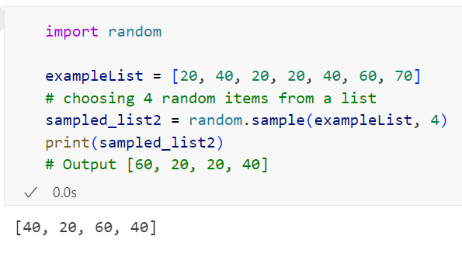
Points to remember about random.sample()
It doesn’t change the specified sequence or list. It returns a new sampled list containing elements from the specified sequence or list.
The specified list or sequence need not be hashable or unique.
Important Note: If your list contains repeated or duplicate elements, then sample() can pick repeated items because each occurrence is a possible selection in the sample. It chooses the repeated items from the specified list if the unique members are less than a sampling size.
Let’s see the example which demonstrates the same.

Slide 62
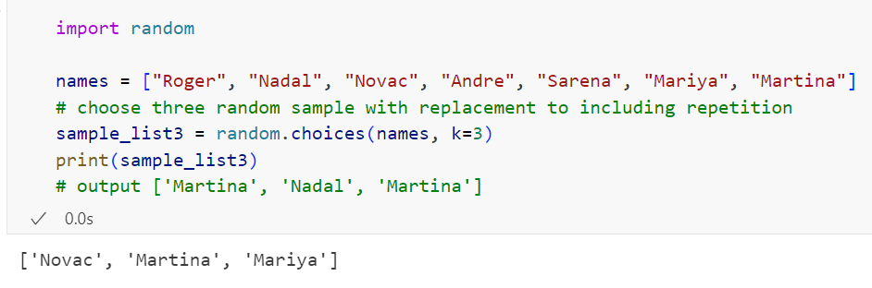
random sample with replacement to including repetitions:
Use the random.choices() function to select multiple random items from a sequence with repetition. For example, You have a list of names, and you want to choose random four names from it, and it’s okay for you if one of the names repeats.
A random.choices() function introduced in Python 3.6. Let see this with an example.

Slide 63
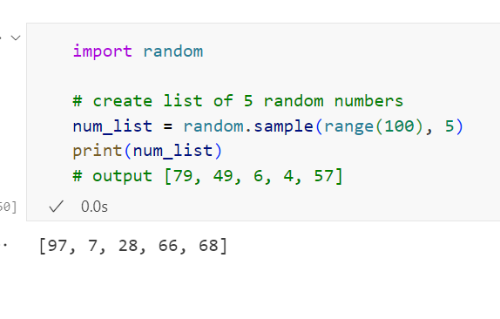
Generate the sampled list of random integers
You can use random.randint() and random.randrange() to generate the random numbers, but it can repeat the numbers. To create a list of unique random numbers, we need to use the sample() method.
Warp a range() function inside a sample() to create a list of random numbers without duplicates. The range() function generates the sequence f random numbers.

Slide 64

On top of it, you can use the random.shuffle() to shuffle the list of random integers.
Note: We used the range() with a random.sample to generate a list of unique random numbers because it is fast, memory-efficient, and improves the performance for sampling from a large population.

Slide 65

A random sample from the Python set
Python set is an unordered collection of unique items. Same as the list, we can select random samples out of a set. Let’s see how to pick 3 random items from a set.

Slide 66
Random sample from Python dictionary
Python Dictionary is an unordered collection of unique values stored in (Key-Value) pairs.
The sample() function requires the population to be a sequence or set, and the dictionary is not a sequence. If you try to pass dict directly you will get TypeError: Population must be a sequence or set.
So it would be best if you used the dict.items() to get all the dictionary items in the form of a list and pass it to the sample() along with the sampling size (The number of key-value pairs you want to pick randomly out of dict).
Let’s see the example to select a two samples of key-value pair from the dictionary.

Slide 67


Slide 68

Random seed to get the same sample list every time
Seed the random generator to get the same sampled list of items every time from the specified list.
Pass the same seed value every time to get the same sampled list
Note: To get the same sampled list every time, you need to find the exact seed root number.

Slide 69

Note:
The above all examples are not cryptographically secure. If you are creating samples for any security-sensitive application, then use a cryptographically secure random generator, use the random.SystemRandom().sample() instead of random.sample().
Get a sample array from a multidimensional array
Most of the time, we work with 2d or 3d arrays in Python. Let assume you want to pick more than one random row from the multidimensional array. Use the numpy.random.choice() function to pick multiple random rows from the multidimensional array.

Slide 70
random.sample() function Error and exception
A sample function can raise the following two errors.
ValueError: If the sample size is larger than the population or sequence (i.e., list or set) size.
TypeError: If any of the two arguments is missing.

Slide 71

Python weighted random choices to choose from the list with different probability
This concept demonstrates ways to choose single or multiple elements from the list randomly with a different probability. Use the random.choices() function to get the weighted random samples in Python.
Let’s take the following example for a better understanding of the requirement

Slide 72
If we execute the random.choice() in the above code, it will give you 10, 20, 30, or 40 with equal probability. But what if you want to pick the element from the list with a different probability. For example, choose a list of items from any sequence in such a way that each element has a different probability of being selected.
In other words, choose 4 elements from the list randomly with different probabilities. For example:
Choose 10 – 10% of the time
Choose 20 – 25% of the time
Choose 30 – 50% of the time
Choose 40 – 15% of the time
There are 2 ways to make weighted random choices in Python
If you are using Python 3.6 or above then use the random.choices()
Else, use a numpy.random.choice()
We will see how to use both one by one.

Slide 73
Contents:
random.choices()
Syntax
Relative weights to choose elements from the list with different probability
Cumulative weights to choose items from the list with different probability
Choose a single element form list with different probability
Probability of getting 6 or more heads from 10 spins
Generate weighted random numbers
Points to remember before implementing weighted random choices
Numpy’s random.choice() to choose elements from the list with different probability

Slide 74
random.choices()
Python 3.6 introduced a new function random.choices() in the random module. By using the choices() function, we can make a weighted random choice with replacement. You can also call it a weighted random sample with replacement.
Syntax
Let’s have a look at the syntax of this function.
random.choices(population, weights=None, *, cum_weights=None, k=1)
It returns a k sized list of elements chosen from the population with replacement.
Parameters
population: It is is sequence or data structure from which you want to choose data.
weights or cum_weights: Define the selection probability for each element.
weights: If a weights sequence is specified, random selections are made according to the relative weights.
cum_weights: Alternatively, if a cum_weights sequence is given, the random selections are made according to the cumulative weights.
k: The number of samples you want from a population.

Slide 75

Note: You cannot specify both weights and cum_weights at the same time.
As mentioned above we can define weights sequence using the following two ways
Relative weights
Cumulative weights

Slide 76

Relative weights to choose elements from the list with different probability
First, define the probability for each element. If you specified the probability using the relative weight, the selections are made according to the relative weights. You can set relative weights using the weight parameter.
Example: Choose 5 elements from the list with different probability

Slide 77

Note:
As you can see in the output, we received an item ‘555‘ three times because we assigned the highest weight to it. So it has the highest probability to be selected
Weights sum is not 100 because they’re relative weights, not percentages.
The following rule determines the weighted probability of selecting each element.
Probability = element_weight/ sum of all weights
In the above example, the probability of occurring each element is determined is as follows

Slide 78
Cumulative weights to choose items from the list with different probability:
To make selections according to the cumulative weights, use the cum_weights parameter.
Note: Python converts the relative weights to cumulative weights before making selections. So, I suggest you pass cumulative weights to saves time and extra work.
he cumulative weight of each element is determined by using the following formula.
cum_weight= Weight of previous element + own weight
For example, the relative weights [5, 10, 15, 20] are equivalent to the cumulative weights [5, 15, 30, 50].
Let’s see how to use cumulative weights to choose 4 elements from a list with different probability.

Slide 79


Slide 80

Choose a single element form list with different probability
Note: we got “Jon” 3 times in the result because it has the highest probability of being selected

Slide 81

Probability of getting 6 or more heads from 10 spins
Use the cumulative weights to set the probability of getting the head of a coin to 0.61, and the tail of a coin to 0.39 (1 – 0.61 = 0.39)

Slide 82

Generate weighted random numbers
Given a range of integers, we want to generate five random numbers based on the weight. We need to specify the probability/weight for each number to be selected. Let’s see how to generate random numbers with a given (numerical) distribution with different probability

Slide 83
Points to remember before implementing weighted random choices:
If you don’t specify the relative or cumulative weight, the random.choices() will choose elements with equal probability.
The specified weights sequence must be of the same length as the population sequence.
Don’t specify relative weights and cumulative weight at the same time to avoid Type Error (TypeError: Cannot specify both weights and cumulative weights).
You can specify The weights or cum_weights only as integers, floats, and fractions but excludes decimals.
Weights must be non-negative.

Slide 84
Numpy’s random.choice() to choose elements from the list with different probability
If you are using Python version less than 3.6, you can use the NumPy library to make weighted random choices. Install numpy using a pip install numpy.
Using a numpy.random.choice() you can specify the probability distribution.
numpy.random.choice(a, size=None, replace=True, p=None)
a: It is the population from which you want to choose elements. for example, list.
size: It is nothing but the number of elements you want to choose.
p: It Used to specify the probability for each element to be selected.
Note: Probabilities must sum to 1, i.e., when you specify probability weights for each element, the sum of all weights must be 1.
Example:

Slide 85


Slide 86
Python random.seed() function to initialize the pseudo-random number generator
Table of contents
What is a seed in a random generator?
Why and When to use the seed() function
How to use random.seed() function
Syntax of random.seed()
random seed() example to generate the same random number every time
Another Example
Set system time as a seed value instead of OS-specific randomness source
Get a seed value used by a random generator
Python random seed with randrange
Use the Random seed and choice method together
Use random seed and sample function together
Use random seed and shuffle function together

Slide 87
What is a seed in a random generator?
The seed value is a base value used by a pseudo-random generator to produce random numbers. The random number or data generated by Python’s random module is not truly random; it is pseudo-random(it is PRNG), i.e., deterministic. The random module uses the seed value as a base to generate a random number.
Use a random.seed() function with other random module functions to reproduce their output again and again.
Why and When to use the seed() function
Random module’s seed() function particularly useful in programming contexts where you want the same sequence of random numbers to be generated each time the code is run, such as in simulations, testing, and data science.
Also, the random.seed() is useful to reproduce the data given by a pseudo-random number generator. By re-using a seed value, we can regenerate the same data multiple times as multiple threads are not running.
For example:
We can choose the same elements from the list randomly every time using random.seed().
Always produces the same random number
Shuffles the list in the same way to produce the same sequence of elements
Also, the seed value is very significant in computer security to pseudo-randomly generate a secure secret encryption key. So using a custom seed value, you can initialize the robust and reliable pseudo-random number generator the way you want.
When we supply a specific seed to the random generator, you will get the same numbers every time you execute a program. That is useful when you need a predictable source of random numbers.

Slide 88
How to use random.seed() function
Let’s understand the working of a seed() function.
Syntax of random.seed()
random.seed(a=None, version=2)
It initialize the pseudo-random number generator with seed value a.
Parameters: –
It accepts two parameters. Both are optional.
a: It is the seed value. If the a is None, then by default, current system time is used.
If the operating system provides randomness sources, they are used instead of the system time. For example, On windows, the os.urandom() internally uses CryptGenRandom() to generate random data.
If you pass a seed value in the form of an integer, it is used as it is.
version: If the version is set to 2 by default, str, bytes, or bytearray object gets converted to an int, and all of its bits are used.
When we say OS-specific randomness source it means: –
On Linux, the getrandom() function can be used to get random bytes in non-blocking mode
On a Unix-like system, random bytes are read from the /dev/urandom device
On Windows, it will use CryptGenRandom().

Slide 89

Important points:
If you don’t initialize the pseudo-random number generator, then the random generator uses the OS’s randomness sources to set the seed value. That’s why whenever we execute the random.random(), we get a different number.
When Python failed to get the OS-specific randomness source then by-default current system time is used as a seed value.
random seed() example to generate the same random number every time:
If you want to generate the same number every time, you need to pass the same seed value before calling any other random module function. It means any subsequent random operations will produce the same results each time the script is run with the same seed.
As we can see in the output, we got the same number three times because we seeded them with the same value before calling a random.randint().

Slide 90

Example 2: Using seed for different purpose.

Slide 91

Example 3: shuffles the list in the same way with seed 30.
This is useful in producing the sequence of elements with seed 30.

Slide 92

Another Example
Suppose you call a random.randint() twice before calling a seed() you will get a different number. If you want different data, then pass the different seed value before calling any other random module function.

Slide 93
We got a different number in the second place in the output because we executed randint() twice without setting the seed value.
Note:
Setting the seed affects all subsequent calls to random number generation functions in the random module. If you need randomness that is not reproducible, simply do not set the seed or change it.
You can also use the getstate() and setstate() functions, which help us to capture the current internal state of the random generator.
Capture and store the current state using a random.getstate(). Next, whenever you want the same result change the current state of the random number using the random.setstate(state).
By changing the current state to the previous state we can get the same random data again

Slide 94

Set system time as a seed value instead of OS-specific randomness source:
For any reason, if you want to set a custom seed other than an OS-specific randomness source, a common practice is to use system time in milliseconds as a seed value.

Slide 95
Get a seed value used by a random generator
Sometimes it is useful to be able to reproduce the data given by a pseudo-random number generator. As you already know, random data generation is dependent on a seed value. By re-using a seed value, we can regenerate the same data multiple times as multiple threads are not running.
For example, You want to reproduce the results you are getting in a particular run. In such cases, you want to know the seed used to replicate that result. The current seed value is essential when you want reproducible results.

Slide 96


Slide 97

The above way is time-based, so each time you execute it, it will produce a different seed, and if you like the result, you can use that seed to get the same result back.
Now, I will use the same seed (7616533358804326209) to get the same result back.
Note: Using the above approach you can reproduce the result of any random module function

Slide 98

Python random seed with randrange
Let see how to use seed() function to get the same random number within a given range.

Slide 99

Use the Random seed and choice method together
The random choice() function is used to choose a random element from the list and set. By setting the custom seed value, you can pick the same choice every time.

Slide 100

Use random seed and sample function together
Using a random sample() function, we can select random samples from the list and other sequence types. Let’s see how to get the same random samples out of the list every time using a seed() and sample() function.

Slide 101

Use random seed and shuffle function together
We can also use the seed() and random.shuffle() functions together. The primary purpose of using the seed() and shuffle() function together is to produce the same result every time after each shuffle. If we set the same seed value every time before calling the shuffle() function, we will get the same item sequence. I.e., shuffling produces the same result every time.

Slide 102

Python random.shuffle() function to shuffle list
you will learn how to shuffle a list in Python using the random.shuffle() function. Also, learn how to shuffle string, dictionary, or any sequence in Python.
When we say shuffle a list, it means a change in the order of list items. For example, shuffle a list of cards.
You’ll learn the following functions of a random module to randomize a list in Python.

Slide 103
Table of contents
The random.shuffle() function
Shuffle a List
Randomly Shuffle Not in Place
Option 1: Make a Copy of the Original List
Option 2: Shuffle list not in Place using random.sample()
Shuffle Two Lists At Once With Same Order
Shuffling NumPy Multidimensional Array
Shuffle a List to Get the Same Result Every time
Shuffle a String
Shuffle a String by Converting it to a List
Approach Two: Shuffling a String, not in place
Shuffle Range of Integers
Shuffle a Dictionary in Python
Shuffle a Python generator

Slide 104
The random.shuffle() function
Syntax
random.shuffle(x, random)
It means shuffle a sequence x using a random function.
Parameters:
The random.shuffle() function takes two parameters. Out of the two, random is an optional parameter.
x: It is a sequence you want to shuffle such as list.
random: The optional argument random is a function returning a random float number between 0.1 to 1.0. This function decides how to shuffle a sequence. If not specified, by default Python uses the random.random() function.
Note: this parameter deprecated since version 3.9, will be removed in version 3.11
Return Value
It shuffles sequence in place and doesn’t return anything, i.e., It returns None. This function changes the position of items in a mutable sequence.

Slide 105
Shuffle a List
Use the below steps to shuffle a list in Python
Create a list
Create a list using a list() constructor. For example, list1 = list([10, 20, 'a', 'b'])
Import random module
Use a random module to perform the random generations on a list
Use the shuffle() function of a random module
Use the random.shuffle(list1) function to shuffle a list1 in place.the shuffle() shuffles the original list, i.e., it changes the order of items in the original list randomly and doesn’t return a new list
Display the shuffled list
As shuffle() function doesn’t return anything. Use print(list1) to display the original/resultant list.
Get shuffled list instead of modifying the original list
Use the random.sample() function to shuffle the list not in place to get the new shuffled list in return instead of changing the original list. OR
Make a copy of the original list before shuffling (Ideal way)
Customize the shuffling if needed
If you want to perform shuffling as per your need, you can pass a custom function in the place of the random argument, which will dictate the shuffle() function on how to randomize a list’s items.

Slide 106


Slide 107

Randomly Shuffle Not in Place
As you know, the shuffle() works in place and returns None, i.e., it changes the order of items in the original list randomly. But most of the time, we need the original list or sequence.
We can keep the original list intact using the following two ways. These options don’t modify the original list but return a new shuffled list.
Option 1: Make a Copy of the Original List
Make a copy of the original list before shuffling (Ideal and preferred)

Slide 108
Option 2: Shuffle list not in Place using random.sample()
Use the random.sample() function to shuffle list not in place to get the new shuffled list in return instead of changing the original list
The random.sample() function returns the random list with the sample size you passed to it. For example, sample(myList, 3) will return a list of 3 random items from a list.
If we pass the sample size the same as the original list’s size, it will return us the new shuffled list.
Let’s see the example. In this example, I am shuffling the list of Employee objects.

Slide 109



Slide 110
Waring: As per the official Python documentation, for small len(x), the total number of permutations of x can quickly grow more extensive than the period of most random number generators. This implies that most permutations of a long sequence can never be generated. For example, a sequence of length 2080 is the largest that can fit within the Mersenne Twister random number generator period. So I advise you to use the use first approach.
Shuffle Two Lists At Once With Same Order:
Let’s assume if you want to Shuffle two lists and maintain the same shuffle order. For example, One list contains employee names, and the other includes a salary. Let’s see how to randomize multiple lists by maintaining their order.

Slide 111



Slide 112

Shuffling NumPy Multidimensional Array
NumPy module has a numpy.random package to generate random data. In this example, I am using Python’s Numpy module to create a 2d array. Also, Using numpy.random.shuffle() function, we can shuffle the multidimensional array.

Slide 113
Shuffle a List to Get the Same Result Every time
Let’s how to seed the random generator in such a way that shuffling produces the same result every time. Using the seed() and shuffle() together, we can generate the same shuffled list every time.
Do you know how PRNG works in Python?
Python’s random module is not truly random. It is pseudo-random (PRNG), i.e., deterministic. The random module uses the seed value as a base to generate a random number. By default, current system time is used as a seed value. If we change the seed value, we can change the output
Note :We are getting the same list because we use the same seed value before calling the shuffle function. This is just a simple example. To make it work with any list, we need to find the exact seed root number for that list, which will produce the output we desire.

Slide 114


Slide 115

Shuffle a String
In this section, we will see how to shuffle String in Python. But it is not as simple as shuffling a list. You will get an error if you try to shuffle a string using the shuffle() method.
Because a string is an immutable type, and You can’t modify the immutable objects in Python. The random.shuffle() doesn’t’ work with String. I.e., It can’t accept string argument. Let’s understand this with the help of the following example.
We have a solution to this. We can shuffle a string using various approaches. Let see each one by one.

Slide 116

Shuffle a String by Converting it to a List
Convert String to list and Shuffle the list randomly, again convert the shuffled list into String

Slide 117

Approach Two: Shuffling a String, not in place
Using this approach, we can keep the original string unchanged and get the new shuffled string in return. Also, we don’t need to convert the string to a list to get the shuffled string.
The sample() function returns a sample from a sequence as per the sample size you passed to it. For example, sample(str, 3) will return a list of 3 random characters from a list.

Slide 118

Shuffle Range of Integers
A range() function returns a sequence of numbers.
The range() doesn’t return the list, so when you try to run shuffle(range(10)), you will get an error. To shuffle numbers in the range(10), first convert the range to a list.

Slide 119

Shuffle a Dictionary in Python
Shuffling a dictionary is not possible in Python. However, we can rearrange the order of keys of a dictionary.
Fetch all keys from a dictionary as a list.
Shuffle that list and access dictionary values using shuffled keys.

Slide 120
Shuffle a Python generator:
The random.shuffle() needs to know the sequence’s size to shuffle the sequence uniformly. If you try to shuffle a generator object using it, you will get a TypeError: the object of type 'generator' has no len().
As the generator cannot provide us the size we need to convert it into a list to shuffle it.
If we pass the sample size the same as the string size, it will return us the new shuffled string of characters.

Slide 121


Slide 122
Generate Random Float numbers in
Python using random() and Uniform()

Slide 123

Generate Random Float numbers in Python using random() and Uniform()
you will learn how to generate a random float number in Python using random() and uniform() functions of a random module.
Use the following functions to generate random float numbers in Python. We will see each one of them with examples.

Slide 124
Table of contents
Generate a random float number between 0 to 1
random.uniform() to get a random float number within a range
Syntax
Example
Points to remember about uniform() function
Generate a random float number up to 2 decimal places
Get random decimal
Random float number with step
Generate a list of random floats between a range
Create a list of unique random float numbers
Difference between uniform() and random()
Generate a secure random float number
Use numpy.random to generate an array of random float numbers
Get random float number using a NumPy
Numpy to generate a random float number between range
Create an n-dimensional array of float numbers

Slide 125

Generate a random float number between 0 to 1
Use a random.random() function of a random module to generate a random float number uniformly in the semi-open range [0.0, 1.0).
Note: A random() function can only provide float numbers between 0.1. to 1.0. Us uniform() method to generate a random float number between any two numbers.

Slide 126
random.uniform() to get a random float number within a range
The random.uniform() function returns a random floating-point number between a given range in Python. For example, It can generate a random float number between 10 to 100 Or from 50.50 to 75.5.
Syntax
random.uniform(start, stop)
The random.uniform() function returns a random floating-point number N such that start <= N <= stop.
In simple words, uniform(10.5, 15.5) will generate any float number greater than or equal to 10.5 and less than or equal to 20.5.
Parameters
The uniform() function accepts two arguments, and both are compulsory. If you miss any of them, you will get a TypeError uniform() missing 1 required positional argument.
start: it is the star number in a float range. i.e., lower limit. The default value is 0 if not specified.
stop: It is the end/last number in a range. It is the upper limit.
Example
Let see how to use the random.uniform() function to get a random float number within a range.

Slide 127


Slide 128
Points to remember about uniform() function
The start value need not be smaller than the stop value.
If start <= stop, it generates a random float number that is greater than or equal to the start number and less than or equal to the stop number.
If stop <= start, it generates a random float number that is greater than or equal to the stop number and less than or equal to the start number.
For example, you can use random.uniform() to generate a random float number between 10 to 100 and from 100 to 10. Both are treated the same.
The step argument is not available in random.uniform()
Generate a random float number up to 2 decimal places
As you can see in the above examples, a random float number has more than ten decimal places. In many cases, we need a random float number with limited decimal digits after the decimal point.
Use the round() function inside the random.random() and random.uniform() function to limit float number precision to two decimal places.

Slide 129


Slide 130

Get random decimal
The random.uniform() and random.random() only returns float number. To get a random decimal.Decimal instance, you need explicitly convert it into decimal.Decimal.

Slide 131

Random float number with step
Let’s see how to generate a random float number from a range() with a specific interval (The step value).
For example, If you want to get a random integer from a range(1, 100, 2) with an interval 2, you can do that easily using random.choice(range(1, 100, 2)). But as you know, range() doesn’t support the float numbers. In this case, we need to convert an integer to floats.
Note: we used random.choice() to choose a single number from the range of float numbers.

Slide 132

Generate a list of random floats between a range
In this section, we will see how to generate multiple random float numbers. In this example, we will see how to create a list of 10 random floats within a range of 50.50 to 500.50.
Note: In the above example, there is a chance to get duplicate float numbers in a list. let’s see how to generate a list of unique random floats.

Slide 133

Random float number with step
Let’s see how to generate a random float number from a range() with a specific interval (The step value).
For example, If you want to get a random integer from a range(1, 100, 2) with an interval 2, you can do that easily using random.choice(range(1, 100, 2)). But as you know, range() doesn’t support the float numbers. In this case, we need to convert an integer to floats.
Note: we used random.choice() to choose a single number from the range of float numbers.

Slide 134

Generate a list of random floats between a range
In this section, we will see how to generate multiple random float numbers. In this example, we will see how to create a list of 10 random floats within a range of 50.50 to 500.50.
Note: In the above example, there is a chance to get duplicate float numbers in a list. let’s see how to generate a list of unique random floats.

Slide 135

Create a list of unique random float numbers
If you want to generate a list of unique random float numbers, you can do that easily using random.sample(range(1, 100), 10)).
The random sample() function never generates the duplicate. But as you know, range() doesn’t support the float numbers. But we have two workarounds to get the list of unique random float numbers. Let’s see those.
Option 1: Use a list of integers to generate floats.
Note: we used the random.sample() to choose 10 numbers from a range of numbers.

Slide 136

Option 2: Avoid duplicates manually

Slide 137
Difference between uniform() and random()
The random() function doesn’t take any parameters, while uniform() takes two parameters, i.e., start and stop.
The random() function generates a random float number between 0.0 to 1.0 but never returns the upper bound. I.e., It will never generate 1.0. On the other side, the uniform(start, stop) generates any random float number between the given start and stop number. Due to the rounding effect, it can return a stop number.
Generate a secure random float number
Above all examples are not cryptographically secure. The cryptographically secure random generator generates random numbers using synchronization methods to ensure that no two processes can obtain the same number at the same time. If you are producing random floats for a security-sensitive application, then you must use this approach.
Use the random.SystemRandom().random() or random.SystemRandom().uniform() functions to generate a secure random float number in Python.

Slide 138


Slide 139


Use the random.SystemRandom().random() or random.SystemRandom().uniform() functions to generate a secure random float number in Python.
Use numpy.random to generate an array of random float numbers
NumPy isn’t a part of a standard Python library. However, it has various functions to generate random data. You can install NumPy using pip install numpy. Let see how to use it to generate a random float number and create an array of random float numbers.
Get random float number using a NumPy
Numpy to generate a random float number between range

Slide 140

Create an n-dimensional array of float numbers
Use a numpy.random.rand() to create an n-dimensional array of float numbers and populate it with random samples from a uniform distribution over [0, 1).

Slide 141

Between any float range
Use a numpy.random.uniform() function to generate a random 2×2 array.

Slide 142
Generate Random Strings and Passwords in Python
Table of contents
String Constants
How to Create a Random String in Python
Example to generate a random string of any length
Random String of Lower Case and Upper Case Letters
Random string of specific letters
Random String without Repeating Characters
Create Random Password with Special characters, letters, and digits
Random password with a fixed count of letters, digits, and symbols
Generate a secure random string and password
Generate a random alphanumeric string of letters and digits
Random alphanumeric string with a fixed count of letters and digits
Generate a random string token
Generate universally unique secure random string Id
Use the StringGenerator module to generate a random string

Slide 143

String Constants:
Below is the list of string constants you can use to get a different set of characters as a source for creating a random string.

Slide 144
How to Create a Random String in Python
We can generate the random string using the random module and string module. Use the below steps to create a random string of any length in Python.
Import string and random module
The string module contains various string constant which contains the ASCII characters of all cases. It has separate constants for lowercase, uppercase letters, digits, and special symbols, which we use as a source to generate a random string.
Pass string constants as a source of randomness to the random module to create a random string
Use the string constant ascii_lowercase
The string.ascii_lowercase returns a list of all the lowercase letters from ‘a’ to ‘z’. This data will be used as a source to generate random characters.
Decide the length of a string
Decide how many characters you want in the resultant string.
Use a for loop and random choice() function to choose characters from a source
Run a for loop till the decided string length and use the random choice() function in each iteration to pick a single character from the string constant and add it to the string variable using a join() function. print the final string after loop competition
Generate a random Password
Use the string.ascii_letters, string.digits, and string.punctuation constants together to create a random password and repeat the first four steps.

Slide 145

Example to generate a random string of any length

Slide 146

The random choice() function is used to choose a single item from any sequence and it can repeat characters.
The above random strings contain all lower case letters. If you want only the uppercase letters, then use the string.ascii_uppercase constant instead in the place of a string.ascii_lowercase.
Random String of Lower Case and Upper Case Letters
In Python, to generate a random string with the combination of lowercase and uppercase letters, we need to use the string.ascii_letters constant as the source. This constant contains all the lowercase and uppercase letters.
Example

Slide 147

Random string of specific letters
If you wanted to generate a random string from a fixed set of characters, please use the following example.

Slide 148

Random String without Repeating Characters
Note: The choice() method can repeat characters. If you don’t want repeated characters in a resultant string, then use the random.sample() method.
Warning: As you can see in the output, all characters are unique, but it is less secure because it will reduce the probability of combinations of letters because we are not allowing repetitive letters and digits.

Slide 149
Create Random Password with Special characters, letters, and digits
A password that contains a combination of characters, digits, and special symbols is considered a strong password.
Assume, you want to generate a random password like: –
ab23cd#$
jk%m&l98
87t@h*ki
We can generate a random string password in Python with letters, special characters, and digits using the following two ways.
Combine the following three constants and use them as a data source for the random.choice() function to select random characters from it.
string.ascii_letters: To include letters from a-z and A-Z
string.digits: To include digits from 1 to 10
string.punctuation: to get special symbols
Use the string.printable constant and choice() function. The string.printable contains a combination of digits, ascii_letters (lowercase and uppercase letters), punctuation, and whitespace.

Slide 150


Using the string.printable

Slide 151
Random password with a fixed count of letters, digits, and symbols
It is a widespread use case that passwords must contain some count of digits and special symbols.
Let’s see how to generate a random password that contains at least one lowercase letter, one uppercase letter, one digit, and one special symbol.
Steps: –
First, select the number of random lowercase and uppercase letters specified
Next, choose the number of random digits
Next, choose the number of special symbols
Combine both letters, digits, and special symbols into a list
At last shuffle the list
Convert list back to a string

Slide 152



Slide 153
Generate a secure random string and password
Above all, examples are not cryptographically secure. The cryptographically secure random generator generates random data using synchronization methods to ensure that no two processes can obtain the same data simultaneously.
If you are producing random passwords or strings for a security-sensitive application, then you must use this approach.
If you are using Python version less than 3.6, then use the random.SystemRandom().choice() function instead of random.choice().
If you are using a Python version higher than 3.6 you can use the secrets module to generate a secure random password.
Use secrets.choice() function instead of random.choice()

Slide 154


Slide 155

Generate a random alphanumeric string of letters and digits
We often want to create a random string containing both letters and digits such as ab23cd, jkml98, 87thki. In such cases, we use the string.ascii_letters and string.digits constants to get the combinations of letters and numbers in our random string.
Now, let’s see the to create a random string with the combination of a letter from A-Z, a-z, and digits 0-9.

Slide 156

Random alphanumeric string with a fixed count of letters and digits
For example, I want to create a random alpha-numeric string that contains 5 letters and 3 numbers. Example

Slide 157

Generate a random string token:
The above examples depend on String constants and random module functions. There are also other ways to generate a random string in Python. Let see those now.
We can use secrets.token_hex() to get a secure random text in hexadecimal format.

Slide 158

Generate universally unique secure random string Id
The random string generated using a UUID module is suitable for the Cryptographically secure application. The UUID module has various functions to do this. Here in this example, we are using a uuid4() function to generate a random string Id.

Slide 159
Use the StringGenerator module to generate a random string
The StringGenerator module is not a part of a standard library. However, if you want you can install it using pip and start using it.
Steps: –
pip install StringGenerator.
Use a render() function of StringGenerator to generate randomized strings of characters using a template
Let see the example now.

Slide 160


Slide 161
Generate Cryptographically secure random numbers and data in Python
In this Concept, I will tell you how to generate a cryptographically secure random number in Python. Random numbers and data generated by the random class are not cryptographically protected. An output of all random module functions is not cryptographically secure, whether it is used to create a random number or pick random elements from a sequence.
What is cryptographically secure pseudo-random number generator?
A cryptographically secure pseudo-random number generator is a random number generator that generates the random number or data using synchronization methods so that no two processes can obtain the same random number simultaneously.
A secure random generator is useful in cryptography applications where data security is essential. Most cryptographic applications require safe random numbers and String. For example, key and secrets generation, nonces, OTP, Passwords, PINs, secure tokens, and URLs.
In this Concept, you’ll learn the following ways to cryptographically secure random number generators in Python
The os.urandom()method
The random.SystemRandom class

Slide 162
Table of contents:
os.urandom() function
Use SystemRandom class to cryptographically secure the random generator
Syntax of SystemRandom class
Secrets module to secure random data

Slide 163

os.urandom() function
The os.urandom() returns a string of size random bytes suitable for cryptographic use.
It can returns a string and random bytes. Random bytes returned by this function depend on the underlying operating system’s random data source (OS.randoms). The quality of randomness is different for each operating system.
On Windows, os.urandom() internally uses CryptGenRandom()
Linux 3.17 and newer, the getrandom() syscall is used when available. On OpenBSD 5.6 and newer, the C getentropy()
function is used.
The data returned by the os.urandom() is enough for cryptographic applications.
Example

Slide 164
The os.urandom() generates a string of random bytes. Use the struct module to convert bytes into the format you want such as integer, float or string.
The struct.unpack(format, buffer) method is used to convert bytes into the format you want – for example, i for integer, and f for float.
A buffer is the source of bytes. In our case, it is os.urandom().
Note: the struct.unpack(format, buffer) returns the result in tuple format.
Let see the example to convert os.urandom() to string, integer, and float.

Slide 165



Slide 166
Use SystemRandom class to cryptographically secure the random generator
Instead of doing the conversion on your own, you can directly use random.SystemRandom class. The SystemRandom class internally uses os.urandom() function to provide the secure random numbers.
SystemRandom class internally uses the os.urandom() function for generating random numbers from sources provided by the operating system.
Use the random module to get this class. Use random.SystemRandom() function to get the instance of SystemRandom class. Using this instance, you can call all random module functions to secure your random data.
Syntax of SystemRandom class
random.SystemRandom([seed])
The seed() method has no effect and is ignored.
The random.getState() and random.setState() function is not available under this class and raises NotImplementedError if called.
Examples
Let see how to use random.SystemRandom to generate cryptographically secure random numbers.
Let’s see the example to secure the output of the functions of the random module such as random(), randint(), randrange(), choice, sample(), uniform().

Slide 167



Slide 168

Secrets module to secure random data
Python 3.6 introduced a new module called secrets for generating a reliable, secure random number, URLs, and tokens.
Refer to our complete guide on Secrets Module to explore this module in detail.
Example

Slide 169
Python Secrets Module to Generate secure random numbers for managing secrets
Python 3.6 introduced a secrets module for generating robust and secure random numbers. In this lesson, you’ll learn how to use secrets.SystemRandom() class and secrets module functions to create random numbers, data, URLs, and tokens securely and safely.
Table of contents
Why use the secrets module
Class secrets.SystemRandom
Secrets Module Functions
randbelow(n)
choice(sequence)
randbits(k)
Generate secure token using secrets module
Example to generate secure tokens
How many bytes tokens should use
Practical Example of secrets module

Slide 170
Why use the secrets module
The cryptographically secure random generator generates random data using synchronization methods to ensure that no two processes can obtain the same data simultaneously.
python secrets functions
The random generator provided by the Python random module is a pseudo-random number generator that is not cryptographically secure. As a result secrets module is added in Python 3.6 and onwards to secure the random number generator.
Before Python 3.6, we have the random() and SystemRandom class to cryptographically secure random generator.
The secrets module is CSPRNG, i.e., cryptographically strong Pseudo-Random Number Generator. It is used to produce random numbers that are secure and useful in security-sensitive applications. The PEP – 0506 is designed to add the secrets module to the Python standard library.
Use the secrets module for following standard security-related functions.
Generating random numbers,
Creating passwords and OTP.
Random token.
Password recovery safe URLs and session keys.
Note: The secrets module available only in Python 3.6 and above. If you are using an older version of Python, please refer to How to secure a random generator in Python.

Slide 171
The secrets module is based on os.urandom() and random.SystemRandom(), an the interface to the operating system’s best source of cryptographic randomness.
On windows, os.urandom() internally uses CryptGenRandom().
Linux 3.17 and newer, the getrandom() syscall used when available.
On OpenBSD 5.6 and newer, the C getentropy() function is used.
Class secrets.SystemRandomw
A class for generating secure random numbers using the highest-quality sources provided by the operating system.
Using the secrets.SystemRandom class, we can use all the functions of a random module.
Before the secrets module, we were using random.SystemRandom class to cryptographically secure random data. The same class is also accessible using the secrets module. Just execute the secrets.SystemRandom(), and it will return the instance of a secure random generator
Let see the example of how to use secrets.SystemRandom class to secure the random generator.

Slide 172



Slide 173

Secrets Module Functions

Slide 174

randbelow(n)
Use the secrets.randbelow function to generate a secure integer number.
This function returns a secure random integer in the range [0, n). Here n is the exclusive upper bound.
0 is the starting number in the range, and n is the last number.
For example, secrets.randbelow(10) generate a single random number from 0 to 9.
Example:

Slide 175

choice(sequence)
The secrets.choice(sequence) method returns a secure randomly-chosen element from a non-empty sequence. Here sequence can be list, tuple, or string.
Example:

Slide 176
randbits(k)
This method returns a secure unsigned integer with k random bits.
This function is to generate a random bitmask that would contain N bits set (this is not the same as generating a random integer since that is not guaranteed to have N bits set in it).
A random number generated using randbits is more secure.
It generates a random integer within a bit range.
If k=4 then Unsigned integer From 0 to 15.
k=8 then Unsigned integer From 0 to 255.
If k=16 then Unsigned integer From 0 to 65,535, and so on.
Let’s see the example :

Slide 177


Slide 178
Generate secure token using secrets module
The secrets module provides functions for generating the secure tokens, useful for applications to generate reset password tokens and hard-to-guess URLs.
Use the following functions to generate a secure token.
secrets.token_bytes([nbytes=None]): Return a secure random byte string containing the number of bytes. If n-bytes are not supplied, a reasonable default gets used.
secrets.token_hex([nbytes=None]): Return a secure random text string in hexadecimal format. The string has n-bytes random bytes, and each byte is converted to two hex digits. If n-bytes are not supplied, a reasonable default gets used.
secrets.token_urlsafe([nbytes=None]): Return a secure random URL-safe text string, containing n-bytes random bytes. Use this method to generate secure hard-to-guess URLs.

Slide 179


Slide 180
How many bytes tokens should use
Tokens need to have sufficient randomness To secure against brute-force attacks and timing attacks. As per experts, 32 bytes (256 bits) of randomness is enough to secure against brute-force attacks. You should choose byte size as per your requirement.
Reduce timing attack using compare_digest(a, b)
To reduce the risk of timing attacks secrets module has the compare_digest(a, b) function. This function returns True if string a and b are equal, otherwise False to reduce the risk of timing attacks.
Practical Example of secrets module
Let see the example now. In this example, we generate a temporary password and send this password on a temporary hard-to-guess URL so the client can reset his password using this URL.
Steps: –
Generate a ten-character alphanumeric password with at least one lowercase character, at least one uppercase character, at least one digits, and one special symbol.
Generate a temporary URL

Slide 181


Slide 182
Python UUID Module to Generate Universally Unique Identifiers
In this article, we will learn how to use the Python UUID module to generate the universally unique identifiers. There are various versions of UUIDs. We will see each one by one with examples.
Goals of this article: –
How to generate a version 1, 3, 4, and 5 UUIDs as specified in RFC 4122
Why and When to use UUID
Generate version 1 UUID using MAC address, sequence number, and the current time.
Get a cryptographically secure random UUID of version 4
Generate a UUID 3 and 5 based Name and cryptographic hash values.
Understand the Structure of UUID
Convert UUID to its String representation.
Convert the String representation of UUID to valid UUID instance.
Generate a reproducible UUID using a seed value
Extract UUID attributes from UUID
finally, What is safe and unsafe UUID

Slide 183
What is UUID?
UUID is a Universally Unique Identifier. You can also call it as GUID, i.e., Globally Unique Identifier. However, What is it? Let’s understand this in brief.
A UUID is 128 bits long number or ID to uniquely identify the documents, Users, resources or information in computer systems.
UUID can guarantee the uniqueness of Identifiers across space and time. when we talk about space and time means when UUID generated according to the standard then the identifier does not duplicate one that has already been created or will be created to identify something else.
Therefore UUID is useful where a unique value is necessary.
Python UUID module implemented as per RFC 4122. RFC 4122 is a standard and Copyright (C) of The Internet Society. RFC 4122 specification includes all the details and algorithms to generate the Unique Identifiers of all the versions. RFC 4122 document specifies three algorithms to generate UUIDs.
Hence using Python UUID module, you can generate versions 1, 3, 4, and 5 UUIDs. UUID generated using this module is immutable.

Slide 184

Python UUID module supports the following versions of UUIDs.
UUID1 – Generate UUID using a Host MAC address, sequence number and the current time. This version uses the IEEE 802 MAC addresses.
UUID3 and UUID 5 uses cryptographic hashing and application-provided text strings to generate UUID. UUID 3 uses MD5 hashing, and UUID 5 uses SHA-1 hashing.
UUID4 uses pseudo-random number generators to generate UUID.
Now, Let see the simple example to get the universally unique Id.

Slide 185

Structure of UUID
As you can see in the output UUID is made up of five components, and each component has a fixed length. A hyphen symbol separates each component. UUID’s presented in the format “8-4-4-4-12”.
The formal definition of the UUID string representation is as follows.

Slide 186
UUID = time_low “-” time_mid “-“time_high_and_version ” “clock_seq_and_reserved_And_clock_seq_low“-” Node.
Let’s understand Why and When to use UUID in our application.
Why and When to use UUID?
Note: When to use UUID is depends on the situation, use case, conditions, and complexity.
To Generate unique Uniform Resource Names. UUIDs are of a fixed size (128 bits) which is reasonably small compared to other alternatives. As you know UUID is unique and persistent, it is an excellent choice for Uniform Resource Names.
Generating UUID doesn’t require a registration process.
We can even use UUID as a transaction ID.
Notable uses in cryptographic applications.
In Web Application
UUID’s are also handy for generating the unique session id to help state management.
To generate a User ID. If you are using auto-increment values to generate user ids Its very simple and easily guessed. People can use an integer value to guess and try to access user using user Id. However, when you use UUID, it is difficult to guess because UUID not created in any sequential format, so it is tough to guess its sequence.

Slide 187
In Database System:
UUID has a significant advantage because UUID is environment independent. i.e., UUID generated on any machine using any application is universally unique.
As most of the applications are depends on the underlying database server to generate a unique or primary key. What if we want to change the database in which the key generation is different. In such a case, a good option is to use UUID in your application to generate a unique database key.
Also, UUID is good for a distributed environment. We can have one table split and placed on multiple physical database servers. If we have an autoincrement key, we have to develop a suitable algorithm to manage that.
Also, UUID is a real value not a pseudo value like a number in an SQL table. Marek Sirkovský medium post describes when to use UUID and when to use other approaches.
When considering the above scenarios, indeed UUID approach is much more unique and universal to generate database Keys. Because Auto-increment isn’t suitable for the distributed system, Most of the database servers including MS SQL Server, MySQL or Oracle, and much more use UUID to generate database keys To identify resources or information uniquely.
Here are some StackOverflow questions which talk more about this in detail.
https://stackoverflow.com/questions/45399/advantages-and-disadvantages-of-guid-uuid-database-keys
https://stackoverflow.com/questions/9377100/when-is-it-appropriate-to-use-uuids-for-a-web-project
Finally, let’s see how to use the UUID module and its functions now.

Slide 188

UUID 1 to Generate a unique ID using MAC Address
The uuid.uuid1() function is used to generate a UUID from the host ID, sequence number, and the current time. It uses the MAC address of a host as a source of uniqueness.
The syntax of uuid1()
uuid.uuid1(node=None, clock_seq=None)
The node and clock_seq are optional arguments.
The node is the hardware address, which is a 48-bit positive integer. If the node not given, then uuid.getnode() function is used to obtain the Universally administered MAC addresses of a current host.
If clock_seq is given, it used as the sequence number. Otherwise, a random 14-bit sequence number is chosen.
Example to generate a unique ID for Host using MAC Address.

Slide 189

Note: uuid1 is not safe it has privacy concerns because it shows the computer’s network address in UUID.
Example to generate a unique ID for Host using node and clock sequence
Each computer has a different MAC address so on each computer you will get different Id. Let’s simulate this by setting explicit node IDs to simulate running on different hosts.

Slide 190

uuid.getnode()
To generate UUID of version 1 we need a hardware address, i.e., MAC address. It is a 48-bit positive integer.
The uuid.getnode()function is used to get the MAC address of a network interface. If the machine has more than one network interface universally administered MAC addresses are returned instead of over locally administered MAC addresses. administered MAC addresses guaranteed to be globally unique
if getnode() function fails to get MAC address it returns the random 48-bit number with the multicast bit as recommended in RFC 4122.

Slide 191

UUID 4 to generate a random UUID
The UUID generated using a uuid4() function is created using a truly Random or Pseudo-Random generator.
Let see the example now.

Slide 192
When should one use uuid1 and uuid4 in python?
uuid1() is guaranteed not to produce any collisions. You can create duplicates UUIDs by creating more 16384 uuid1 in less than 100ns. Don’t use uuid1 when you don’t want to make the MAC address of your machine visible.
UUID4() uses the cryptographically secure random number generator to generate UUID.
uuid4() generates a random UUID. The chance of a collision is small. When UUIDs require to generate on separate machines, or you want to generate a secure UUIDs use UUID4().
furthermore, this excellent answer by Bob Aman on StackOverflow explained this in detail.

Slide 193
UUID 3 and UUID 5 to Create a Name-Based UUID
Version 3 or 5 UUID meant for generating UUIDs from “names.” we can use name and namespace to create a series of unique UUIDs. In simple words version, 3 and 5 UUIDs is nothing but hashing namespace identifier with a name.
The uuid.uuid3(namespace, name) generate a UUID based on the MD5 hash of a namespace identifier (which is a UUID) and a string.
Similarly, the uuid.uuid5(namespace, name) generate a UUID based on the SHA-1 hashing technique of a namespace identifier (which is a UUID) and a name.
The UUID module defines the following namespace identifiers to use with uuid3() or uuid5().
UUID.NAMESPACE_DNS means a fully qualified domain name. For example, https://pynative.com.
UUID.NAMESPACE_URL When this namespace is specified, It means it is a URL.
UUID.NAMESPACE_OID When this namespace is specified, the name string is an ISO OID.
UUID.NAMESPACE_X500 When this namespace is specified, the name string is an X.500 DN in DER or a text output format.
Let see the examples now. Generate a UUID 3 and UUID 5 using the different hostname and namespace.

Slide 194


Slide 195

Example to generate a UUID 3 and UUID 5 using a different namespace.

Slide 196

The Behaviour of uuid3 and UUID 5: –
The UUIDs generated at a different times using the same namespace and same name are equal.
The unique Ids generated from two different names in the same namespace are different.
The UUIDs generated from the same name in two different namespaces are different.
Example: –

Slide 197
Extract UUID attributes read-only attributes
The internal representation of a UUID is a specific sequence of bits in memory, as described in RFC4211. It is necessary to convert the bit sequence to a string representation to represent UUID in string format.
UUID module provides the various read-only argument to access the value of each component of the UUID object. You can extract the values from UUID so we can use this value for a different purpose. For example, You want to Extract the time from a UUID version1 in python.
UUID Read-only Attribute includes the following: –
UUID.bytes: The UUID as a 16-byte string (containing the six integer fields in big-endian byte order).
UUID.bytes_le: It is a 16-byte string that consists of a time_low, time_mid, and time_hi_version.
UUID.fields: A tuple of the six integer fields of the UUID, which are also available as six individual attributes and two derived attributes: UUID.fields has the following fields.

Slide 198


Slide 199
UUID.hex: The UUID as a 32-character hexadecimal string.
UUID.int: The integer representation of a UUID as a 128-bit integer.
UUID.urn: The UUID as a uniform resource name.
UUID.variant: The UUID variant, which determines the internal layout of the UUID. This will be one of the constants RESERVED_NCS, RFC_4122, RESERVED_MICROSOFT, or RESERVED_FUTURE.
UUID.version: the version of UUID. anything between 1, 4, 3, and 5.
UUID.is_safe: To get to know that UUID generation is safe or not. we will see this in the latter section of the article.
Let see how to access these read-only attribute of UUID.

Slide 200



Slide 201

UUID to String and String to UUID in Python:
When we call a uuid.uuid1 or any other version of UUID you will get an instance of UUID class. When we want UUID in string format for comparison, manipulation or maybe for any reason we can get its string representation using a str class. Let see how do change a UUID to a string.

Slide 202

You can also get UUID without dashes. You need to use the string’s replace method to remove the dashes from the string for example.

Slide 203
Now let’s see how to create UUID from String
Assume you received UUID in string format. Now in your application, you need to convert it in the UUID class instance for some operation. Let see how to use a uuid.UUID class to generate a valid UUID from String.
The uuid.UUID is a class which returns a UUID instance when we pass the argument of UUID. Let assume that you have this UUID in string format {018c168c-d509-11e8-b096-ccaf789d94a0}.

Slide 204


Slide 205
Generate Reproducible UUIDs
How to generate a random UUID which is reproducible with seed or with existing UUID attribute in Python?
To Generate the same UUID anytime, you need a seed value. UUID has various attributes as we already discussed above. Using any of its attribute values, we can reproduce the same UUID. Alternatively, you can use seed value to generate the same UUID. Let see both ways.
You can create a UUID instance by passing argument value to uuid.UUID class. For example, you can create a UUID instance from the following inputs: –
UUID.String
UUID.Bytes
UUID.Bytes_le
UUID.Fields
UUID.int
If you have any of the above values, you can generate a UUID. Let see this with an example. I have used all these values of the same UUID. therefore, the result must be the same UUID in all cases.

Slide 206



Slide 207

Reproduce UUID with seed
For testing purposes, we need to generate the same UUID again, and again.i have used the faker module here for a seed value.

Slide 208
Safe and Unsafe UUID
You may have a privacy problem with uuid1 as it use MAC address of your host. On the other hand uuid4() creates a UUID using a random generator.
Also, uuid1 is not safe, i.e. uuid1() may or may not return a “safe.” when we call safe means UUID must be generated using synchronization methods so that no two processes can obtain the same UUID.
Generating safe UUID depends on support from the underlying operating system.
Python 3.7 has added a new attribute to the UUID class using that we can determine UUID is safe or unsafe. Now all the instance of UUID has an is_safe attribute which let us know the UUID is safe or not.
uuid.SafeUUID can return the following values.
safe: The UUID was generated in a multiprocessing-safe way.
unsafe: The UUID was not generated in a multiprocessing-safe way.
unknown: The operating system does not provide information on whether the UUID was generated safely or not.
Let see the example I tested the following code on my windows 7 os to find UUID is safe or not. Let see what it returns.

Slide 209


Slide 210


Slide 211


Slide 212


Slide 213


Slide 214


Slide 215


Slide 216
Assignments
Exercise 1: Generate 3 random integers between 100 and 999 which is divisible by 5
Exercise 2: Random Lottery Pick. Generate 100 random lottery tickets and pick two lucky tickets from it as a winner.
Exercise 3: Generate 6 digit random secure OTP
Exercise 4: Pick a random character from a given String
Exercise 5: Generate random String of length 5
Exercise 6: Generate a random Password which meets the following conditions
Exercise 7: Calculate multiplication of two random float numbers
Exercise 8: Generate random secure token of 64 bytes and random URL
Exercise 9: Roll dice in such a way that every time you get the same number
Exercise 10: Generate a random date between given start and end dates

Slide 217
Thank You

